Slide 1

Decision Trees

Slide 2
Week Goals
Decision Trees: training and application
Overfitting in Decision Trees
Working with categorical features

Slide 3
Example: Predicting the Apartment Price
Target: price of an apartment
Features: Area, Floor, Distance to nearest metro station, etc.

Slide 4
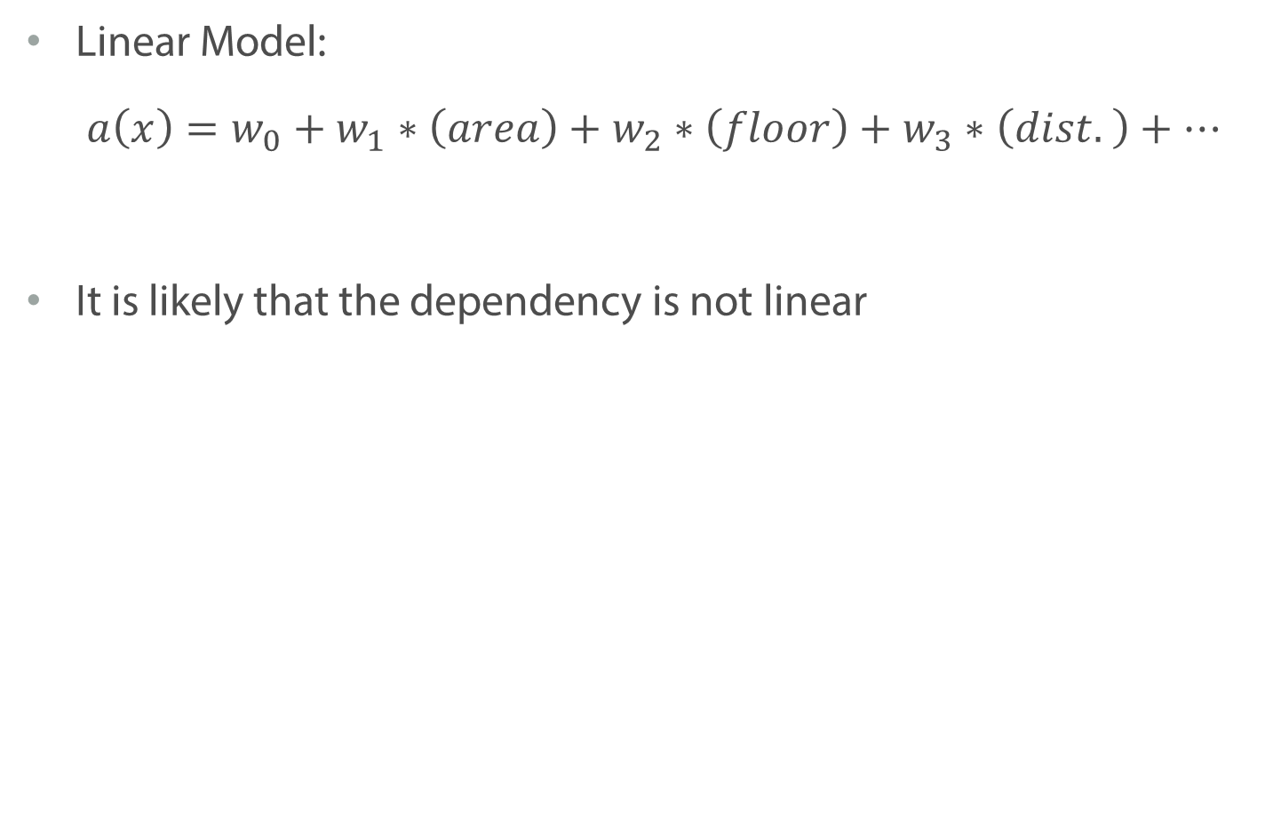
Example: Predicting the Apartment Price
Linear Model:
$$a\left(x\right)=w_{0}+w_{1}∗\left(area\right)+w_{2}∗\left(floor\right)+w_{3}∗\left(dist. \right)+…$$
It is likely that the dependency is not linear

Slide 5
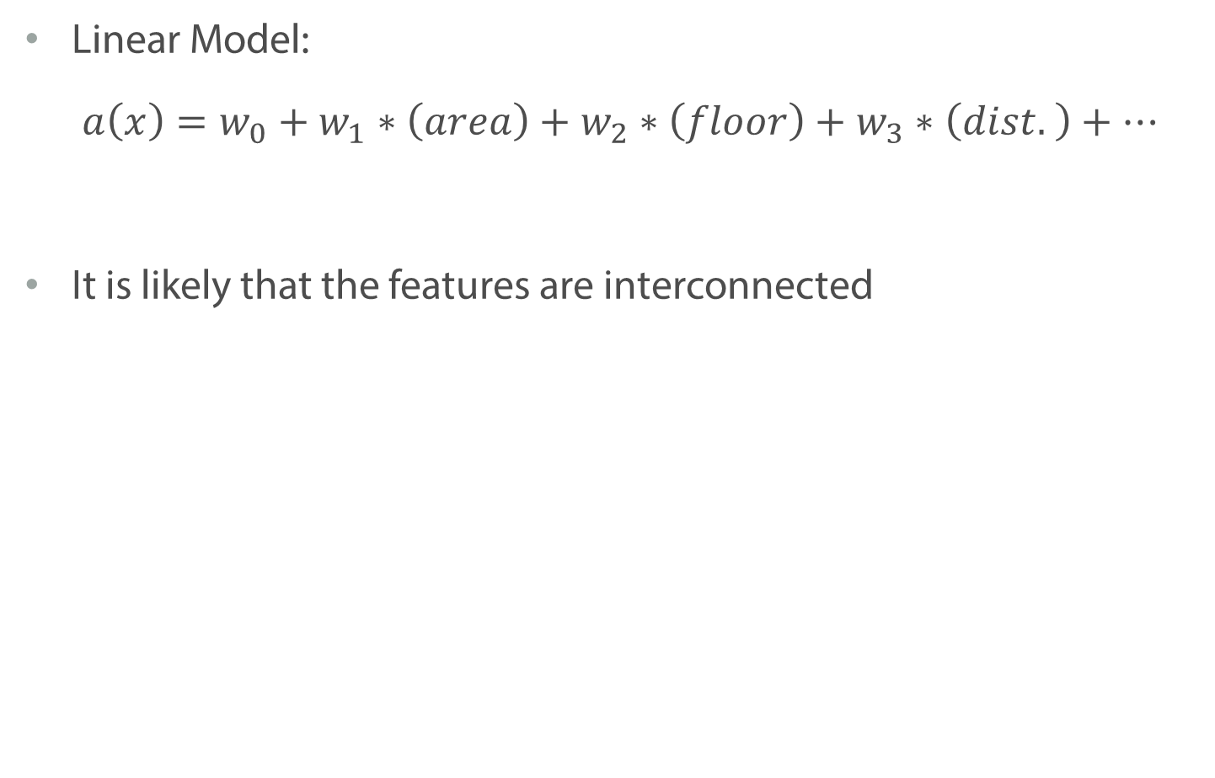
Example: Predicting the Apartment Price
Linear Model:
$$a\left(x\right)=w_{0}+w_{1}∗\left(area\right)+w_{2}∗\left(floor\right)+w_{3}∗\left(dist. \right)+…$$
It is likely that the features are interconnected

Slide 6
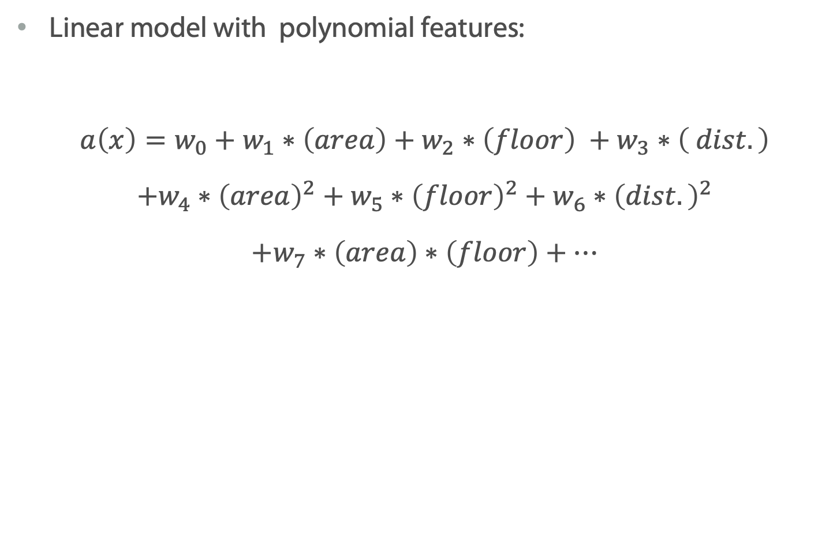
Example: Predicting the Apartment Price
Linear model with polynomial features:
$$a\left(x\right)=w_{0}+w_{1}∗\left(area\right)+w_{2}∗\left(floor\right) +w_{3}∗\left( dist.\right)$$
$$+w_{4}∗{\left(area\right)}^{2}+w_{5}∗{\left(floor\right)}^{2}+w_{6}∗{\left(dist.\right)}^{2}$$
$$+w_{7}∗\left(area\right)∗\left(floor\right)+…$$

Slide 7
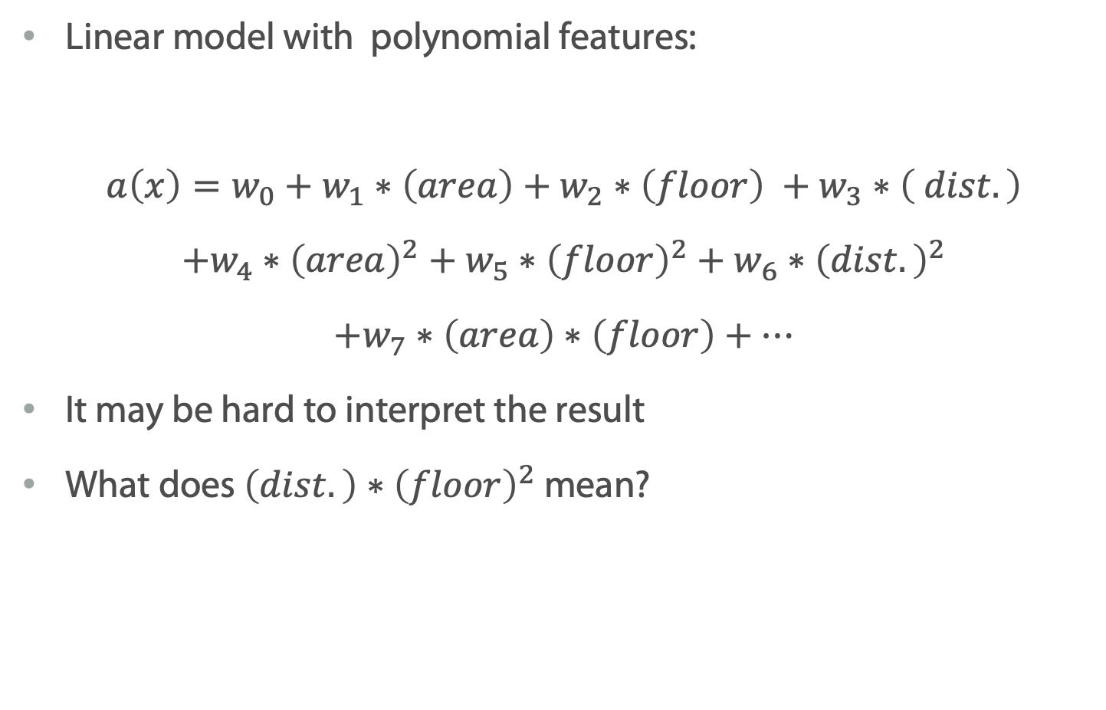
Example: Predicting the Apartment Price
Linear model with polynomial features:
$$a\left(x\right)=w_{0}+w_{1}∗\left(area\right)+w_{2}∗\left(floor\right) +w_{3}∗\left( dist.\right)$$
$$+w_{4}∗{\left(area\right)}^{2}+w_{5}∗{\left(floor\right)}^{2}+w_{6}∗{\left(dist.\right)}^{2}$$
$$+w_{7}∗\left(area\right)∗\left(floor\right)+…$$
It may be hard to interpret the result
What does $\left(dist.\right)∗{\left(floor\right)}^{2}$ mean?

Slide 8
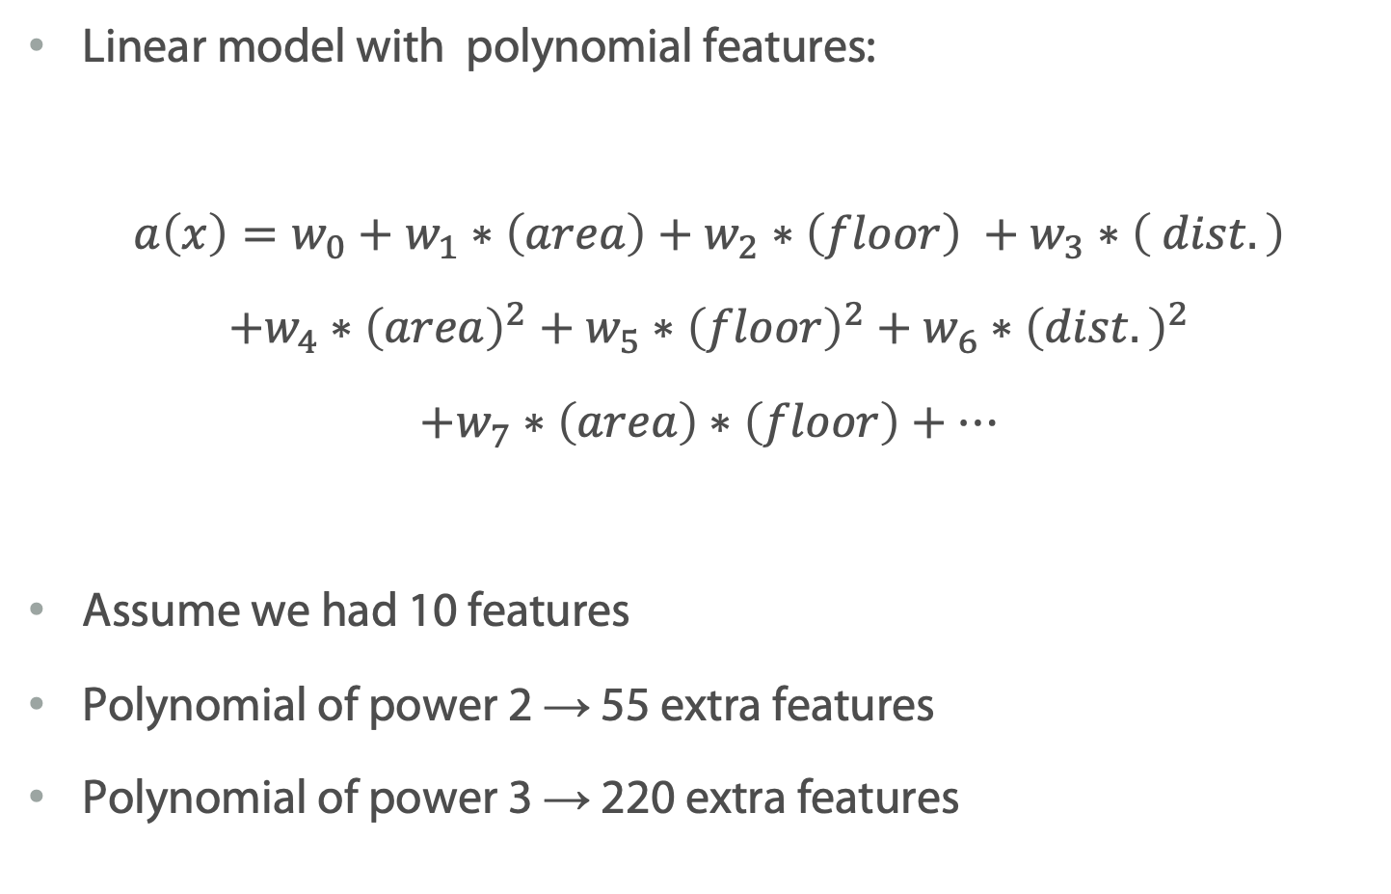
Example: Predicting the Apartment Price
Linear model with polynomial features:
$$a\left(x\right)=w_{0}+w_{1}∗\left(area\right)+w_{2}∗\left(floor\right) +w_{3}∗\left( dist.\right)$$
$$+w_{4}∗{\left(area\right)}^{2}+w_{5}∗{\left(floor\right)}^{2}+w_{6}∗{\left(dist.\right)}^{2}$$
$$+w_{7}∗\left(area\right)∗\left(floor\right)+…$$
Assume we had 10 features
Polynomial of power 2 → 55 extra features
Polynomial of power 3 → 220 extra features

Slide 9
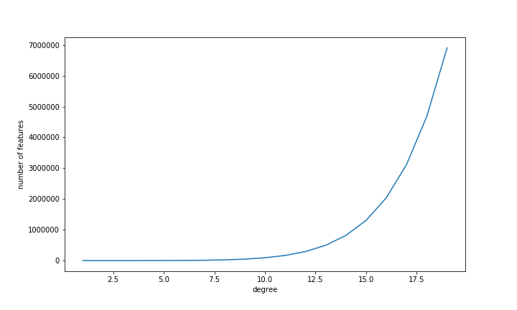
Example: Predicting the Apartment Price
Linear model with polynomial features:

Slide 10
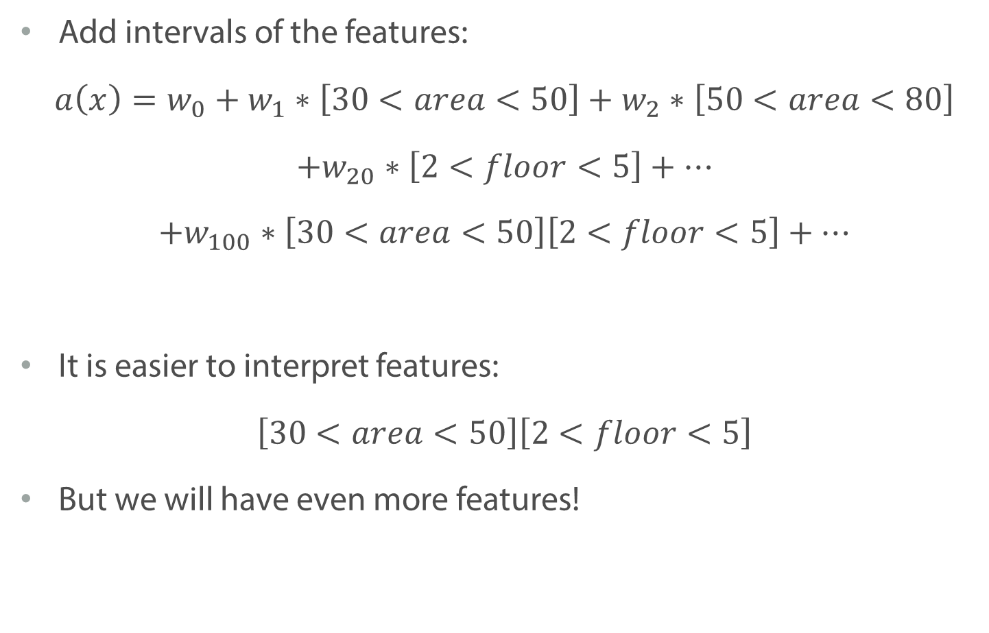
Example: Predicting the Apartment Price
Add intervals of the features:
$$a\left(x\right)=w_{0}+w_{1}∗\left[30<area<50\right]+w_{2}∗\left[50<area<80\right]$$
$$+w_{20}∗\left[2<floor<5\right]+…$$
$$+w_{100}∗\left[30<area<50\right]\left[2<floor<5\right]+…$$
It is easier to interpret features:
$$\left[30<area<50\right]\left[2<floor<5\right]$$
But we will have even more features!

Slide 11
Summary
We need an efficient algorithm to find non-linear dependency between features and target variables
Decision trees will allow us to do that

Slide 12
Decision Trees

Slide 13
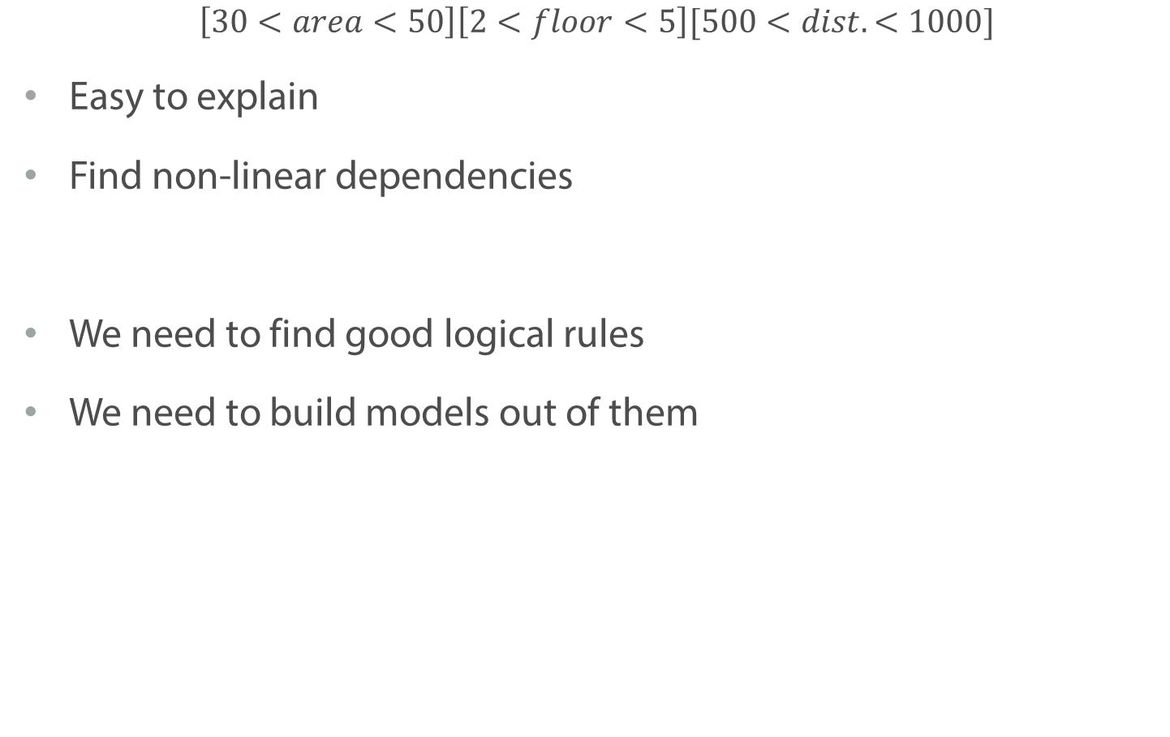
Logical Rule
$$\left[30<area<50\right]\left[2<floor<5\right][500<dist.<1000]$$
Easy to explain
Find non-linear dependencies
We need to find good logical rules
We need to build models out of them
Notes:
Logical rules are cool

Slide 14
Decision Trees
Floor < 3
yes
no
distance < 200
area < 40
yes
no
yes
no
1.000.000
2.000.000
1.000.000
3.000.000
Notes:
We can build a lot of logical rules together and get a binary tree.

Slide 15
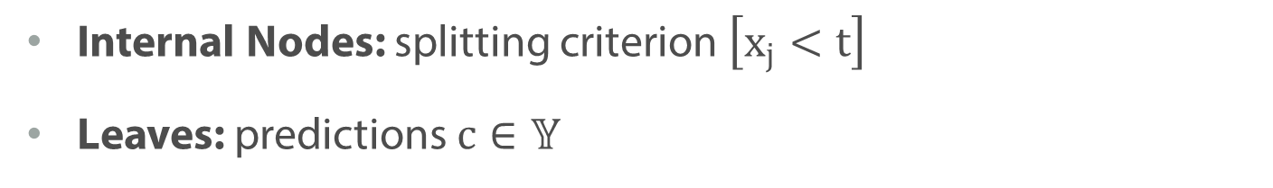
Decision Trees
Floor < 3
yes
no
distance < 200
area < 40
yes
no
yes
no
1.000.000
2.000.000
1.000.000
3.000.000
Internal Nodes: splitting criterion $\left[x_{j}<t\right]$
Leaves: predictions $c∈𝕐$
Notes:
We have 2 types of nodes

Slide 16
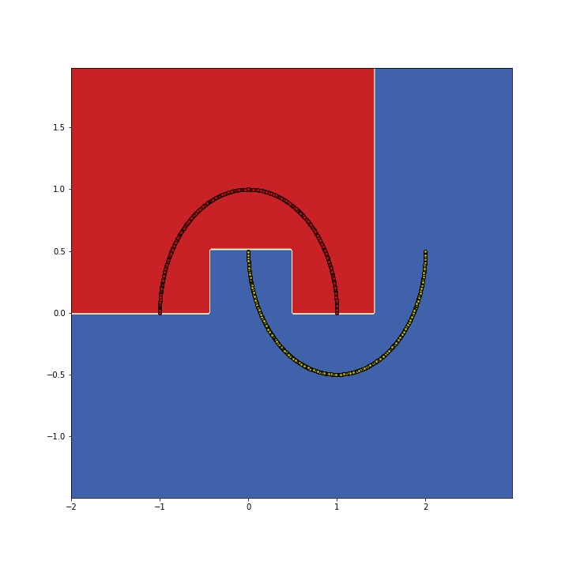
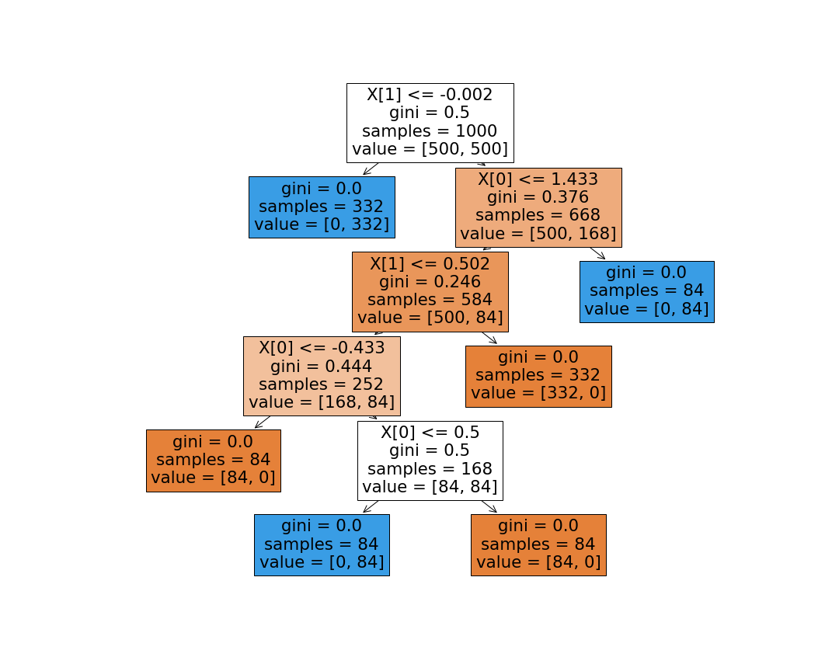
Decision Trees
Notes:
What decision tree gives us – is it splits feature space into rectangular regions and provide a constant prediction in each region. Let’s go through the exact classification tree and see, how it corresponds to features space in the 2d case.

Slide 17
Decision Trees
Notes:
In the root node we split by the feature x1. In the feature space that correspond to horizontal line on the level -0.002. All object below this line will go the left subtree, which is a leaf in our case. Therefore, we have a large blue rectangular below – we predict all objects below to be from the blue class. Let us see what happens if we do to the right subtree.

Slide 18
Decision Trees
Notes:
In the branch we continue splitting the objects. We have threshold base on features x0, which corresponds to the vertical line in the feature space. After the split all objects to the right from the line again end up in the leaf with blue class prediction and the rest are send to the left branch

Slide 19
Decision Trees
Notes:
Here we split the the rest of the observations based on the feature x1 with the threshold of 0.5.
Note that it is the second time when we use feature x1 to perform the split. It can be considered as one of the advantages of decision trees – you can keep choose the same feature several times al different stages to get the best splitting of the feature space

Slide 20
Decision Trees
Notes:
Then we again slit the rest of the dataset based on the feature x0. It gives us one mode red rectangular on the left

Slide 21
Decision Trees
Notes:
And finally we divide the rest of the data into two parts to nicely separate blue and red points

Slide 22
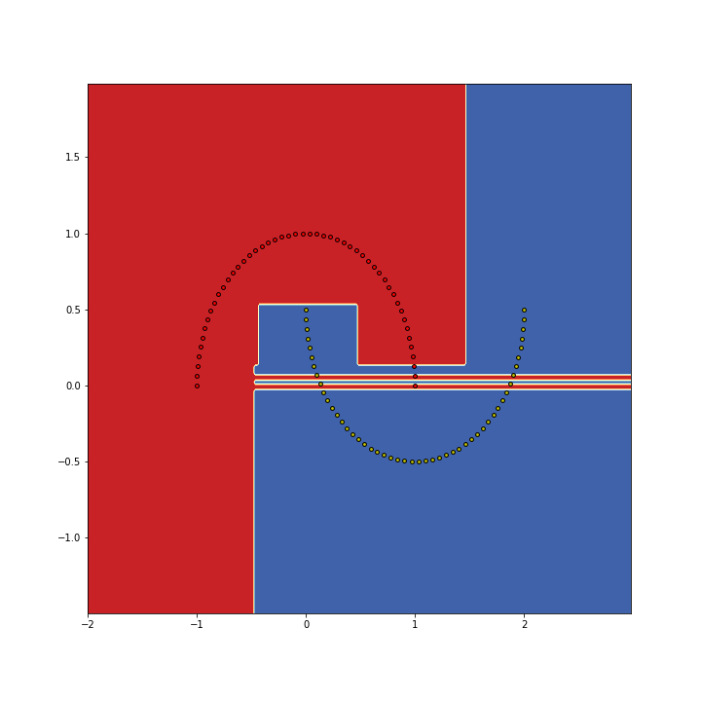
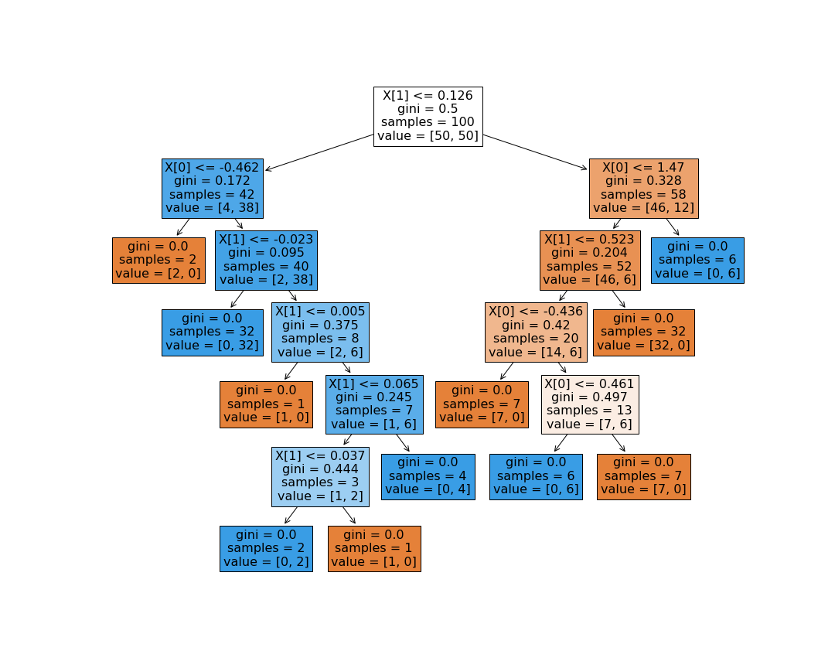
Decision Trees and Overfitting
Notes:
It is worth mentioning that we can continue growing our tree until we get a perfect fit to training data. Unfortunately that my easily result in overfitting. So one have to be really careful with that/

Slide 23
Complexity of Decision Trees
We can keep splitting until we have only one object in each leaf
We can ideally fit any training data
Unless there are several objects with the same features and different target values
Notes:
In general, even though decision trees may look quite simple – they are very powerful
We can perfectly fit any training data unless there are the same objects with different targets values, of course.
To do that it may require to grow our tree until we get to the point when we have only one object in the leaf.

Slide 24
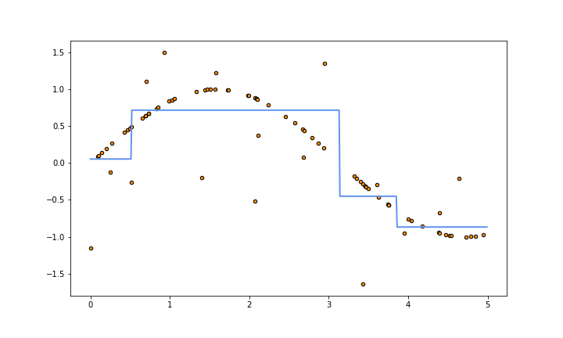
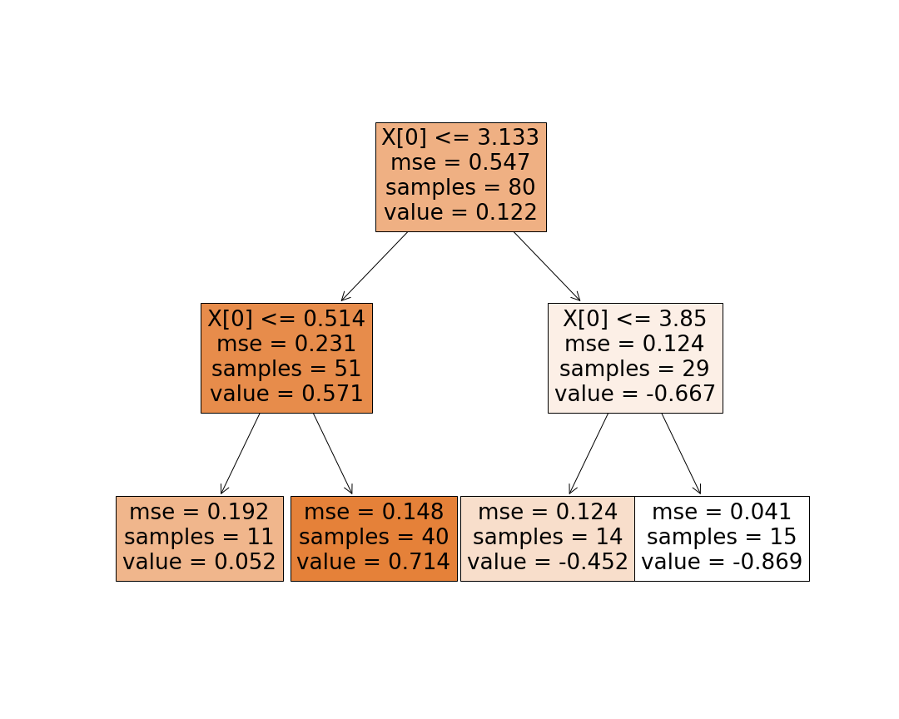
Decision Trees for Regression Task
Notes:
By far we’ve seen how decision trees solve classification task.
But we can also use them to train a regression. It will again split the feature space to the regions of constant predictions. Let us consider the case, when we have only one feature and see how we can approximate a non-linear function using a decision tree.

Slide 25
Decision Trees for Regression Task
Notes:
At the root we select the first threshold to split on. It corresponds to the green line on the graph. All the points which has x0 less that 3.1 will end up in the left subtree, while the rest will go to the right subtree.

Slide 26
Decision Trees for Regression Task
Notes:
For the object in the left part we make one more split by comparing the value of our feature with the 0.5. For all the objects, which have x0 < 0.5 we will predict value around zero, while for the rest of the object from this branch, our prediction will be 0.71.

Slide 27
Decision Trees for Regression Task
Notes:
For the objects from the right subtree, we will also perform one more split define separate constant prediction for the object in to regions that we get

Slide 28
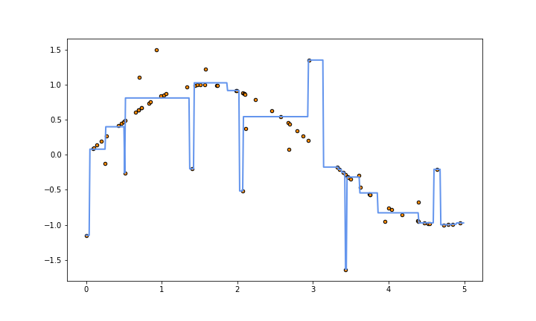
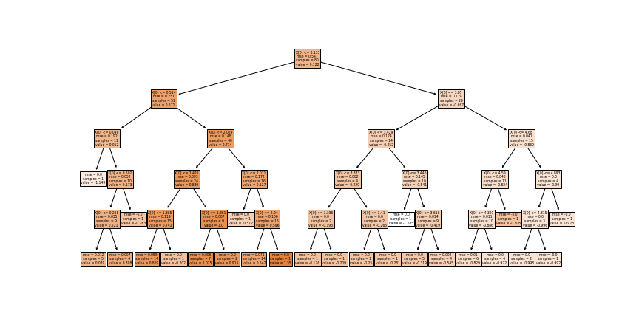
Decision Trees for Regression and Overfitting
Notes:
As well as for the classification task, we can continue growing our tree to perfectly fit training data, Which can easily result in overfitting

Slide 29
Summary
Decision trees — combination of simple logic rules
Decision Trees split feature space into several areas with constant prediction in each of them
It is quite easy to overfit, when you use decision trees
Notes:
To sum up, we saw that binary decision tree is a combination of simple logic rules, where on each step we compare one feature with a threshold a based on the result of a comparison go the right or the left branch.
As a result we get several non-intersecting rectangular regions with constant predictions in each of them
Since we can grow the tree up to a moment, when there is only one object in each leaf, it is quite easy to overfit. So we have to be very careful, when using this model.

Slide 30
Structure of Decision Trees
Notes:
In this video we will continue talking about decision trees

Slide 31
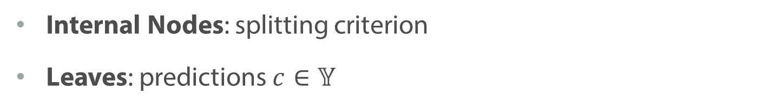
Decision Trees
Floor < 3
yes
no
distance < 200
area < 40
yes
no
yes
no
1.000.000
2.000.000
1.000.000
3.000.000
Internal Nodes: splitting criterion
Leaves: predictions $c∈𝕐$

Slide 32
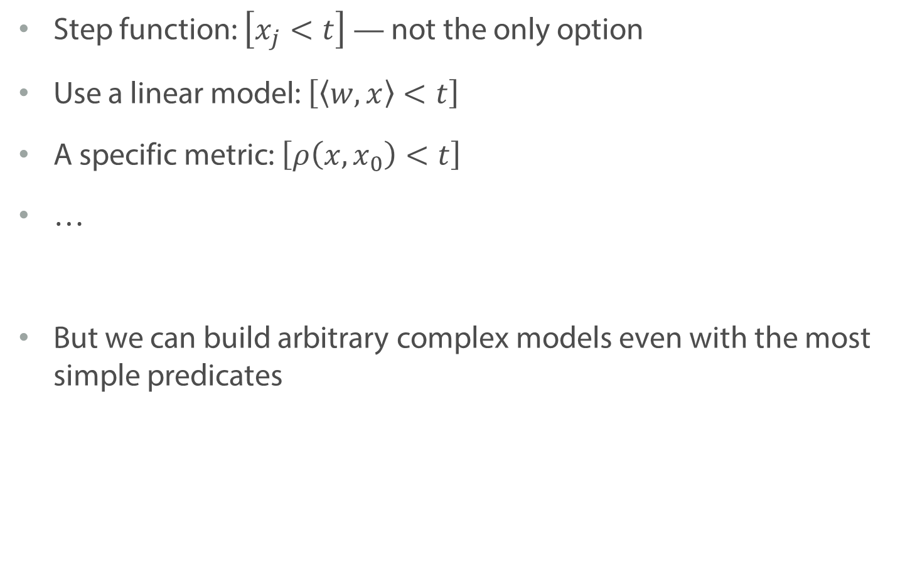
Splitting Criterion
Step function: $\left[x_{j}<t\right]$ — not the only option
Use a linear model: $\left[\left\langle w, x\right\rangle <t\right]$
A specific metric: $\left[ρ\left(x, x_{0}\right)<t\right]$
…
But we can build arbitrary complex models even with the most simple predicates

Slide 33
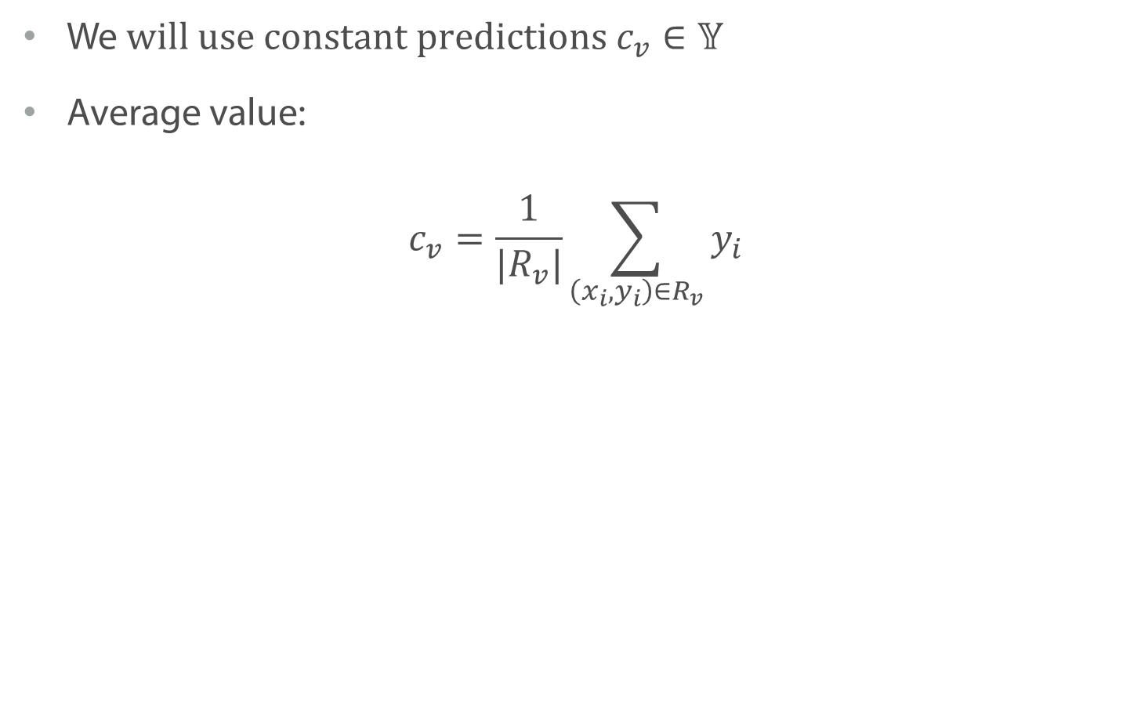
Predictions in Leaves: Regression
We$will use constant predictions c_{v}∈𝕐$
Average value:
$$c_{v}=\frac{1}{|R_{v}|}\sum_{\left(x_{i}, y_{i}\right)∈R_{v}}{y_{i}}$$

Slide 34
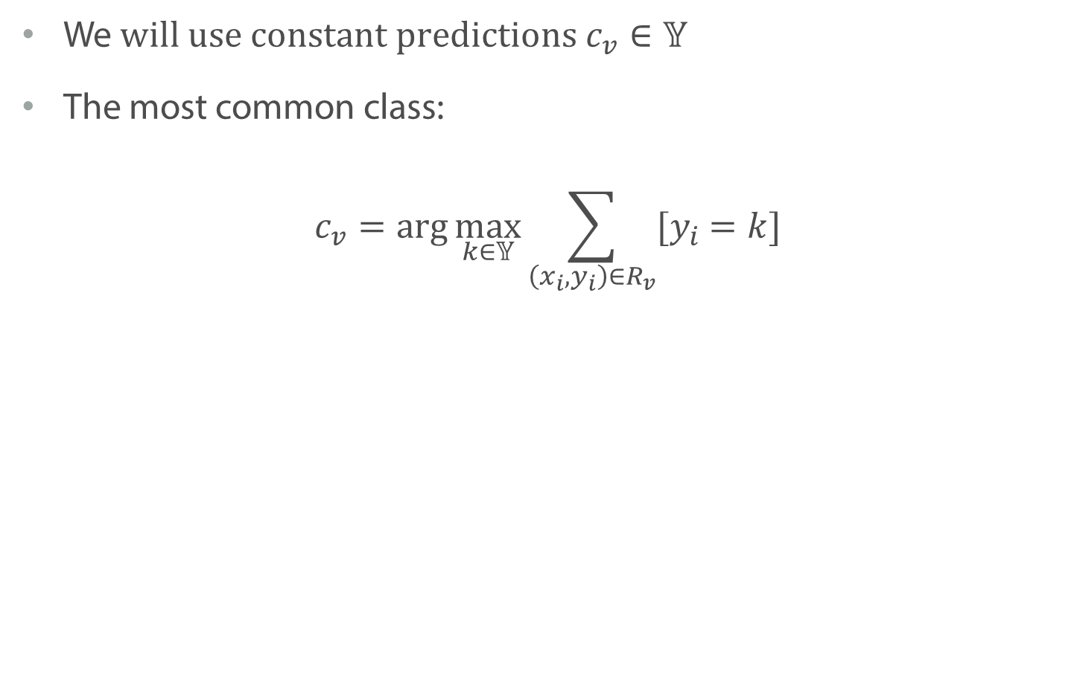
Predictions in Leaves: Classification
We$will use constant predictions c_{v}∈𝕐$
The most common class:
$$c_{v}=\arg{\max_{k∈𝕐}{\sum_{\left(x_{i}, y_{i}\right)∈R_{v}}{{[y}_{i} =k]}}}$$

Slide 35
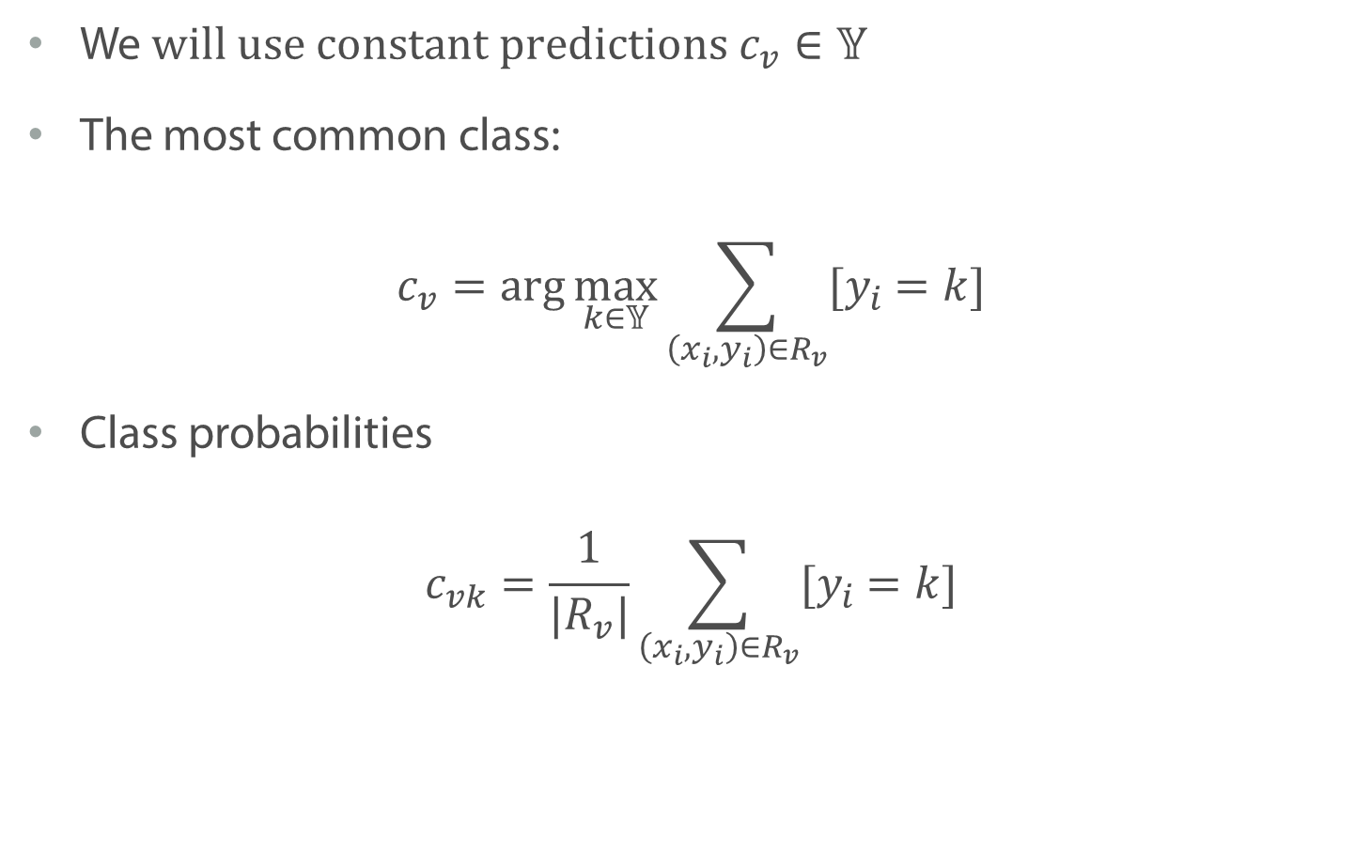
Predictions in Leaves: Classification
We$will use constant predictions c_{v}∈𝕐$
The most common class:
$$c_{v}=\arg{\max_{k∈𝕐}{\sum_{\left(x_{i}, y_{i}\right)∈R_{v}}{{[y}_{i} =k]}}}$$
Class probabilities
$$c_{vk}=\frac{1}{|R_{v}|}\sum_{\left(x_{i}, y_{i}\right)∈R_{v}}{{[y}_{i} =k]}$$

Slide 36
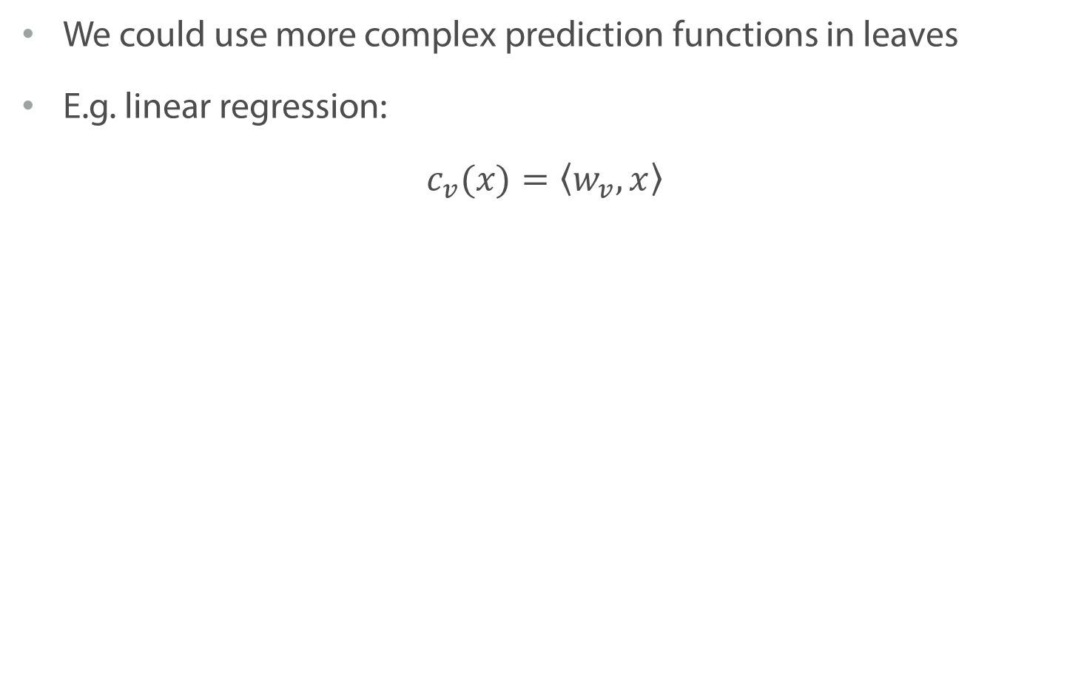
Predictions in Leaves
We could use more complex prediction functions in leaves
E.g. linear regression:
$$c_{v}(x)=\left\langle w_{v}, x\right\rangle$$

Slide 37
Decision Tree

Slide 38
Decision Tree

Slide 39
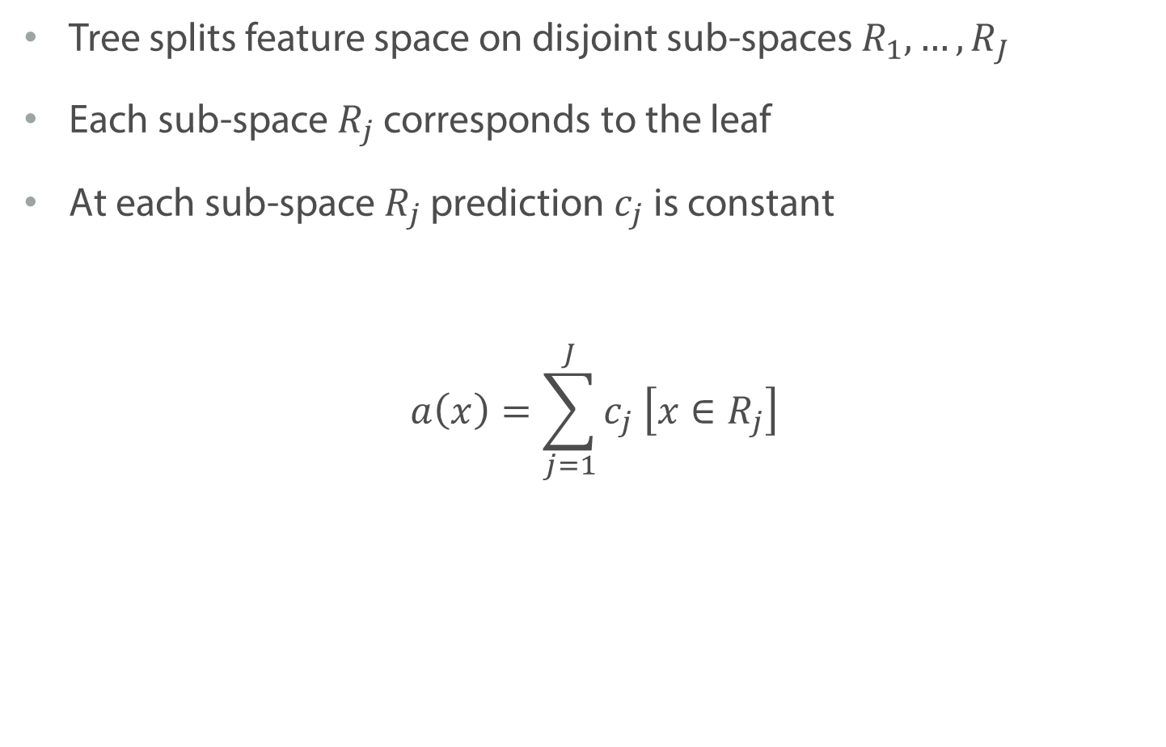
Decision Tree: Interpretation
Tree splits feature space on disjoint sub-spaces $R_{1},…, R_{J}$
Each sub-space $R_{j}$ corresponds to the leaf
At each sub-space $R_{j}$ prediction $c_{j}$ is constant
$$a\left(x\right)=\sum_{j=1}^{J}{c_{j} \left[x∈R_{j}\right]}$$

Slide 40
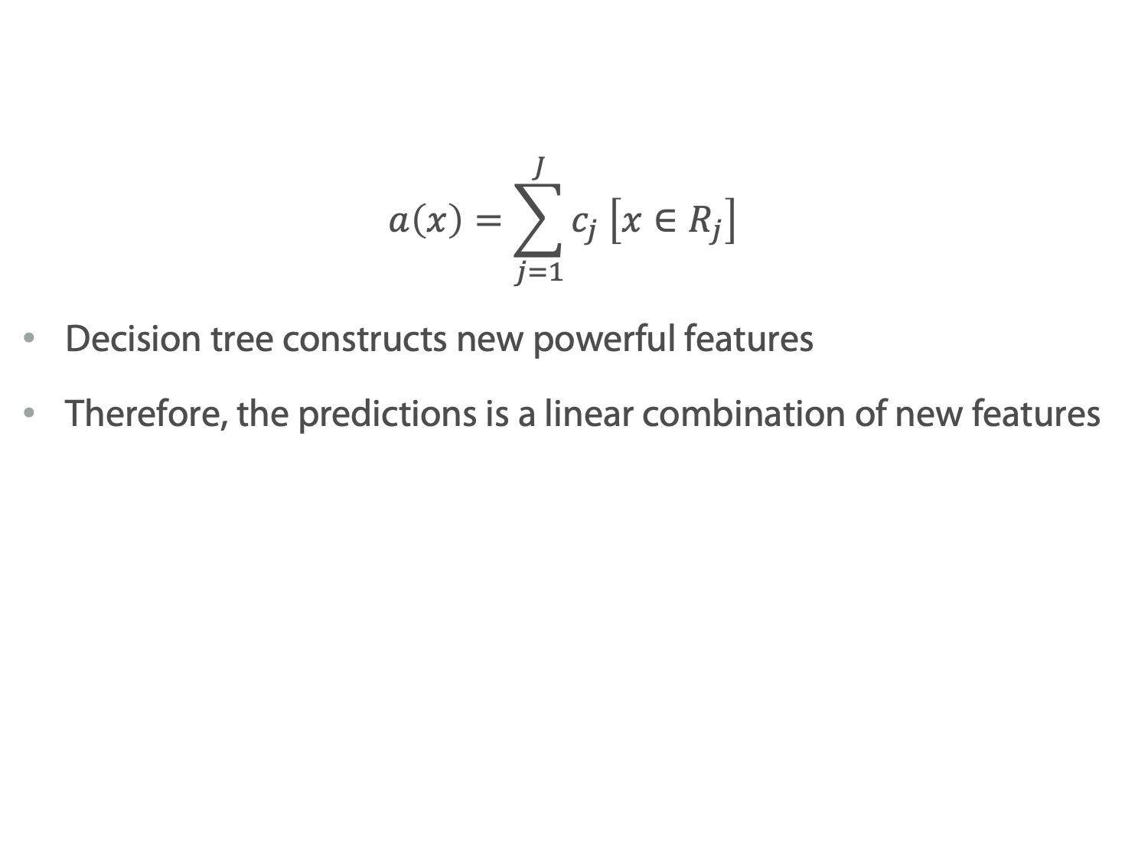
Decision Tree: Interpretation
$$a\left(x\right)=\sum_{j=1}^{J}{c_{j} \left[x∈R_{j}\right]}$$
Decision tree constructs new powerful features
Therefore, the predictions is a linear combination of new features

Slide 41
Summary
One could use different approaches in splitting and making predictions in leaves. Usually the simplest one is good enough.
One could think about decision tree as linear model over new features

Slide 42
How to Train Decision Trees?

Slide 43
Greedy Tree Construction
Let’s develop the algorithm on the example
We start from the classification task

Slide 44
Greedy Tree Construction

Slide 45
Greedy Tree Construction

Slide 46
Greedy Tree Construction

Slide 47
Greedy Tree Construction

Slide 48
Greedy Tree Construction

Slide 49
Greedy Tree Construction

Slide 50
How to Choose Between Two Splits ?
or

Slide 51
Entropy
We consider entropy as a way to measure the uncertainty of an experiment’s outcome

Slide 52
Entropy
We consider entropy as a way to measure the uncertainty of an experiment’s outcome
High entropy
Low entropy

Slide 53
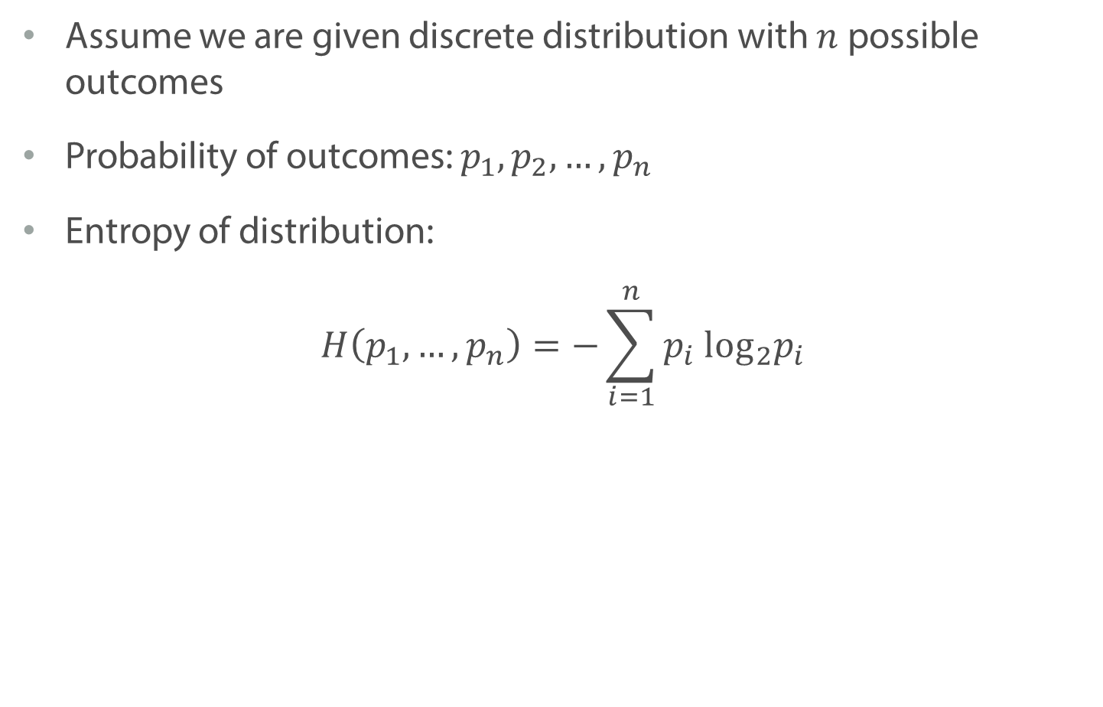
Entropy
Assume we are given discrete distribution with $n$ possible outcomes
Probability of outcomes: $p_{1},p_{2},…, p_{n}$
Entropy of distribution:
$$H\left(p_{1},…, p_{n}\right)=−\sum_{i=1}^{n}{p_{i} {\text{log}}_{2}p_{i}}$$

Slide 54
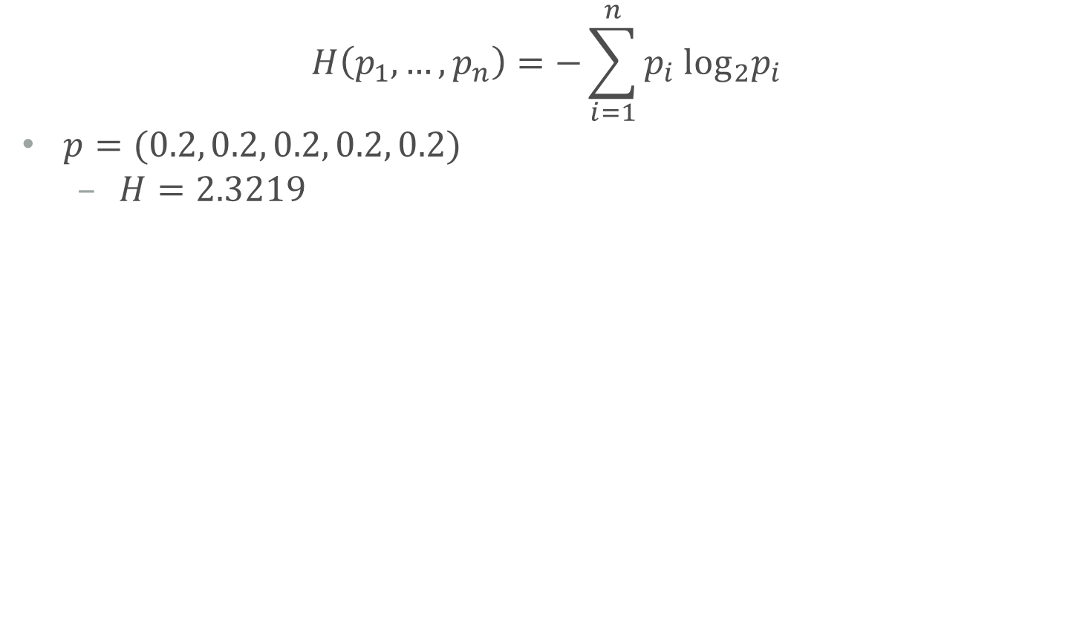
Entropy
$$H\left(p_{1},…, p_{n}\right)=−\sum_{i=1}^{n}{p_{i} {\text{log}}_{2}p_{i}}$$
$p=(0.2, 0.2, 0.2, 0.2, 0.2)$
$H=2.3219$

Slide 55
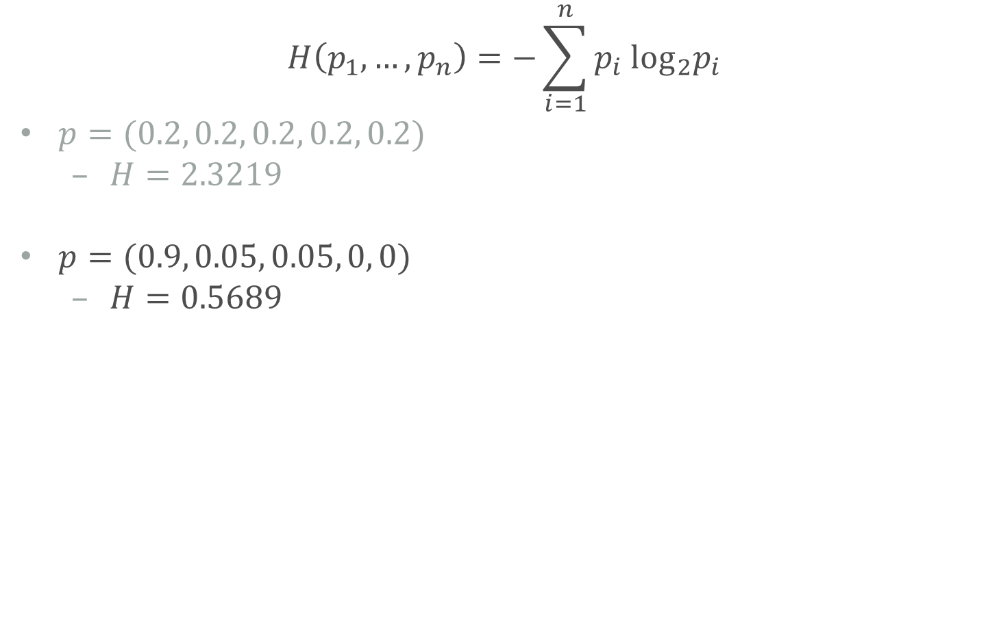
Entropy
$$H\left(p_{1},…, p_{n}\right)=−\sum_{i=1}^{n}{p_{i} {\text{log}}_{2}p_{i}}$$
$p=(0.2, 0.2, 0.2, 0.2, 0.2)$
$H=2.3219$
$p=(0.9, 0.05, 0.05, 0, 0)$
$H=0.5689$

Slide 56
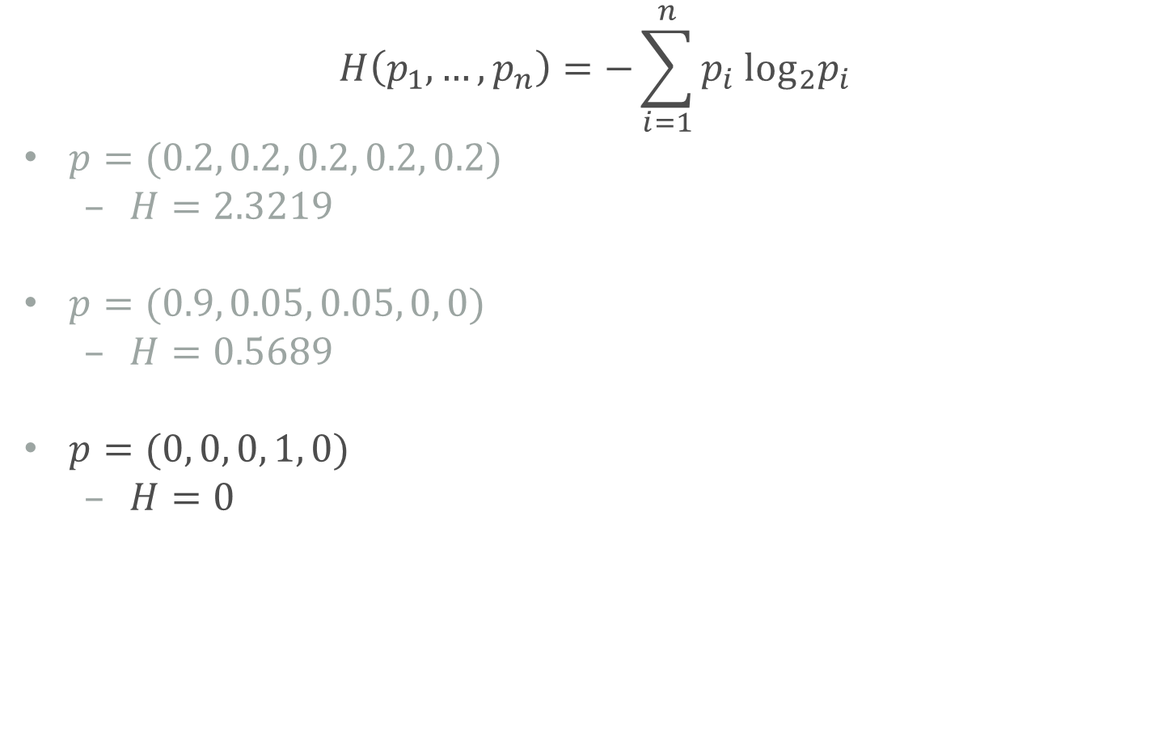
Entropy
$$H\left(p_{1},…, p_{n}\right)=−\sum_{i=1}^{n}{p_{i} {\text{log}}_{2}p_{i}}$$
$p=(0.2, 0.2, 0.2, 0.2, 0.2)$
$H=2.3219$
$p=(0.9, 0.05, 0.05, 0, 0)$
$H=0.5689$
$p=(0, 0, 0, 1, 0)$
$H=0$

Slide 57
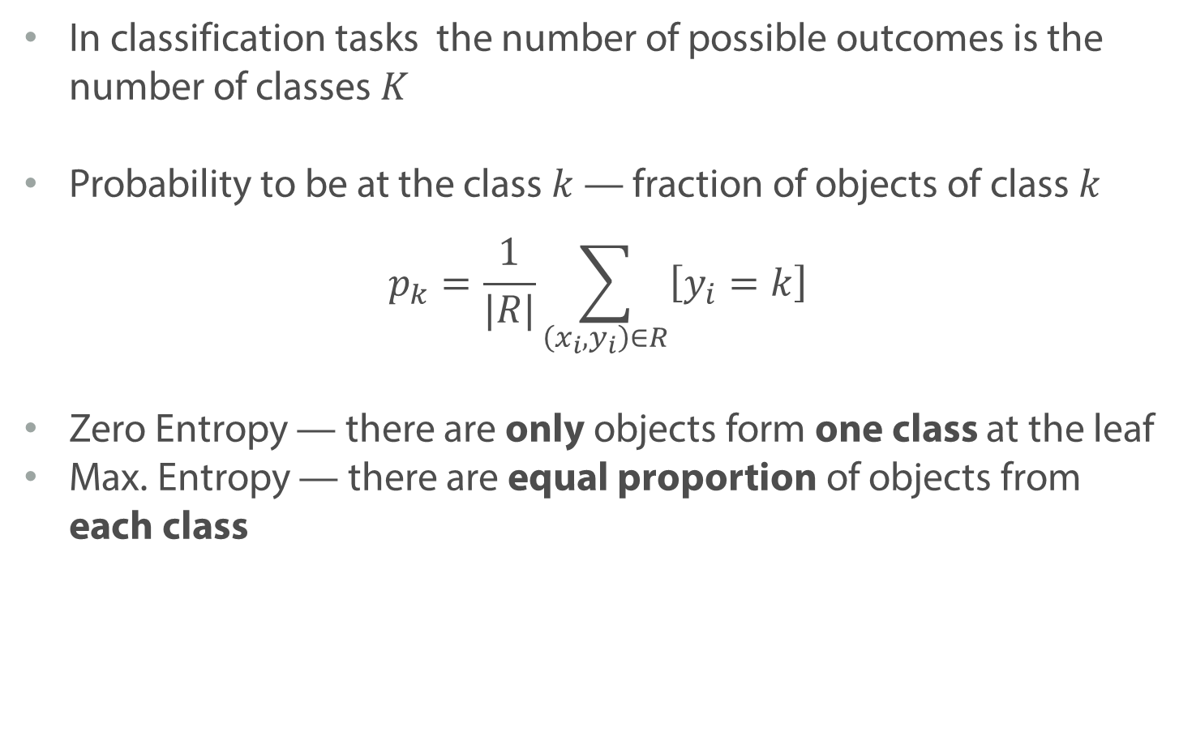
Entropy
In classification tasks the number of possible outcomes is the number of classes $K$
Probability to be at the class $k$ — fraction of objects of class $k$
$$p_{k}=\frac{1}{|R|}\sum_{\left(x_{i}, y_{i}\right)∈R}{\left[y_{i}=k\right]}$$
Zero Entropy — there are only objects form one class at the leaf
Max. Entropy — there are equal proportion of objects from each class

Slide 58
How to Select Between Two Splits?
0.693
0
1.09
1.09

Slide 59
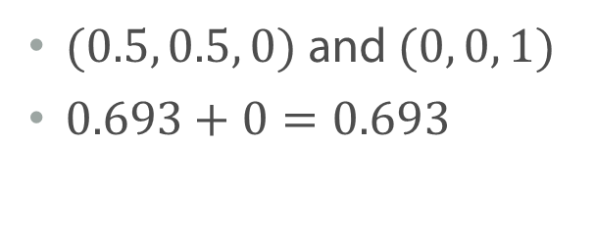
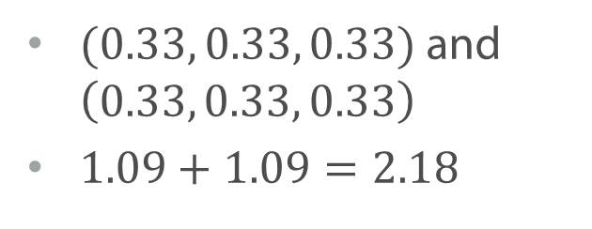
How to Select Between Two Splits?
$(0.5, 0.5, 0)$ and $(0, 0, 1)$
$0.693+0=0.693$
0.693
0
$(0.33, 0.33, 0.33)$ and $\left(0.33, 0.33, 0.33\right)$
$1.09+1.09=2.18$
1.09
1.09

Slide 60
Summary
Decision tree could be constructed in a greedy manner from the root node to the leaves
For classification task we could choose a split, so that it minimizes class diversity at resulting groups

Slide 61
Measures of Impurity

Slide 62
How to Choose Between Two Splits ?
or

Slide 63
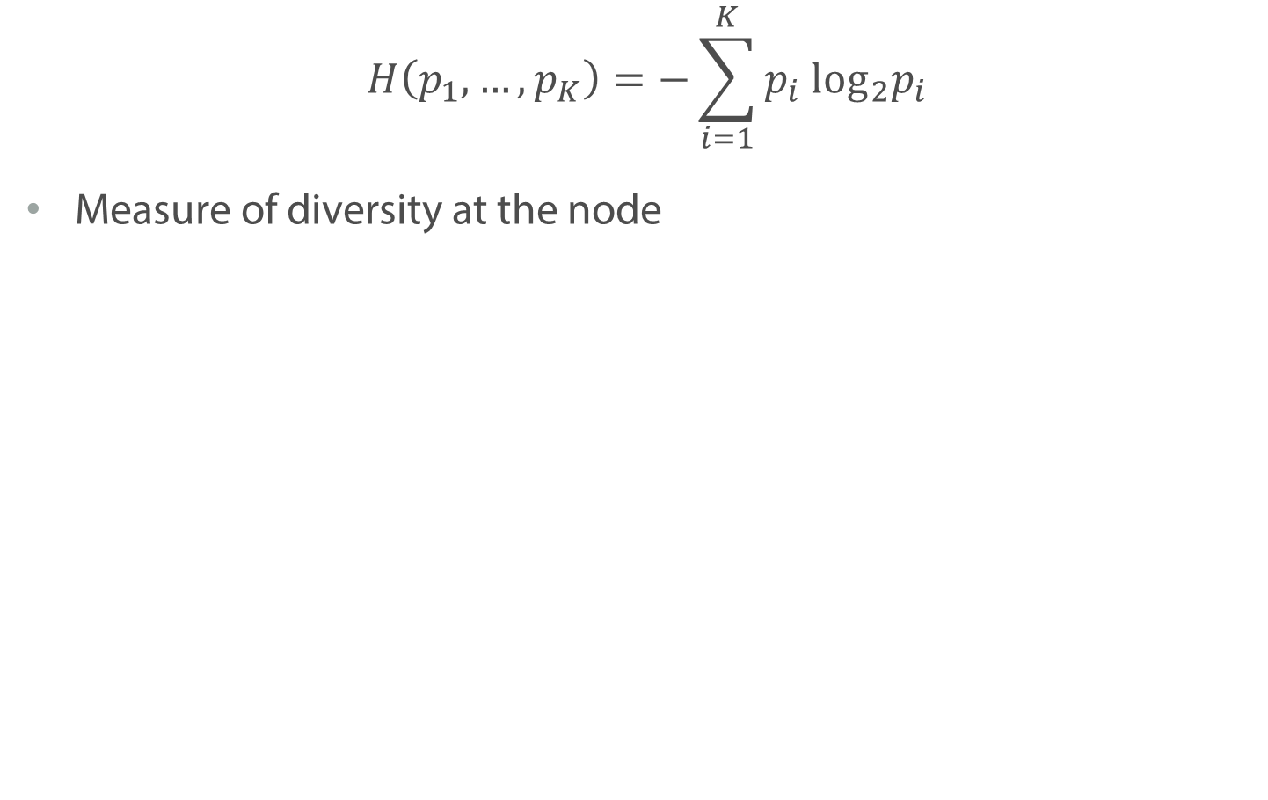
Entropy
$$H\left(p_{1},…, p_{K}\right)=−\sum_{i=1}^{K}{p_{i} {\text{log}}_{2}p_{i}}$$
Measure of diversity at the node

Slide 64
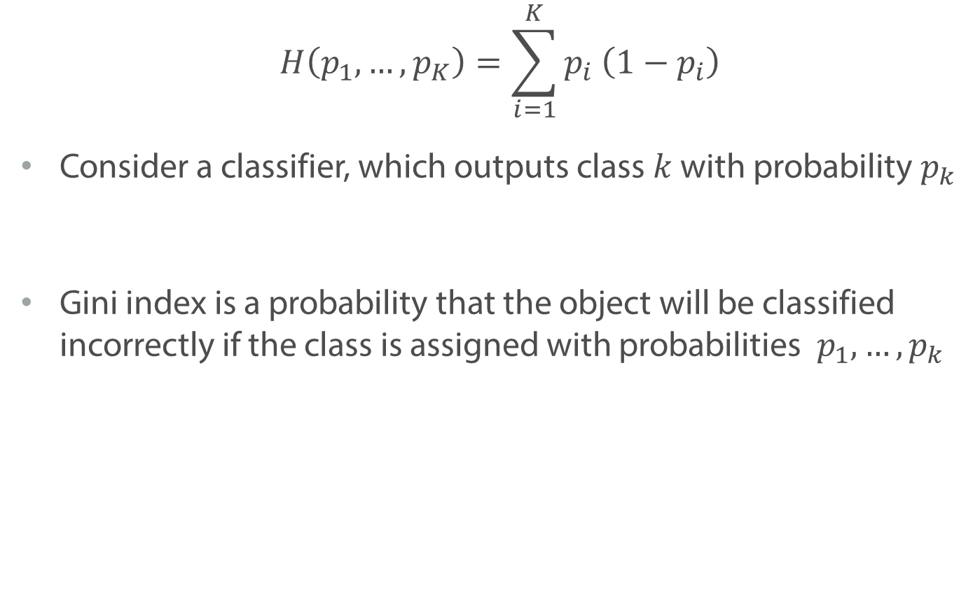
Gini Index
$$H\left(p_{1},…, p_{K}\right)=\sum_{i=1}^{K}{p_{i} \left(1−p_{i}\right)}$$
Consider a classifier, which outputs class $k$ with probability $p_{k}$
Gini index is a probability that the object will be classified incorrectly if the class is assigned with probabilities $p_{1},…,p_{k}$

Slide 65
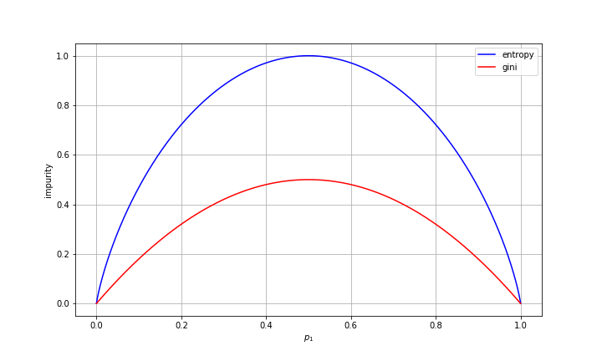
Gini Index vs Entropy

Slide 66
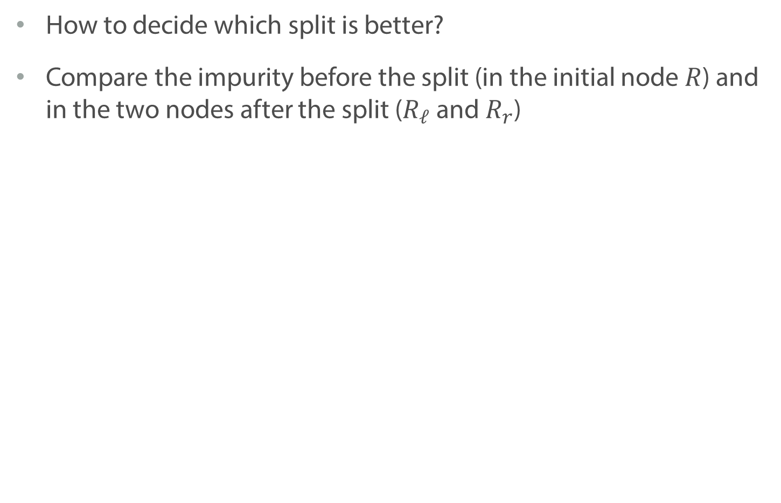
Impurity Criterions
How to decide which split is better?
Compare the impurity before the split (in the initial node $R$) and in the two nodes after the split ($R_{ℓ}$and $R_{r}$)
vs

Slide 67
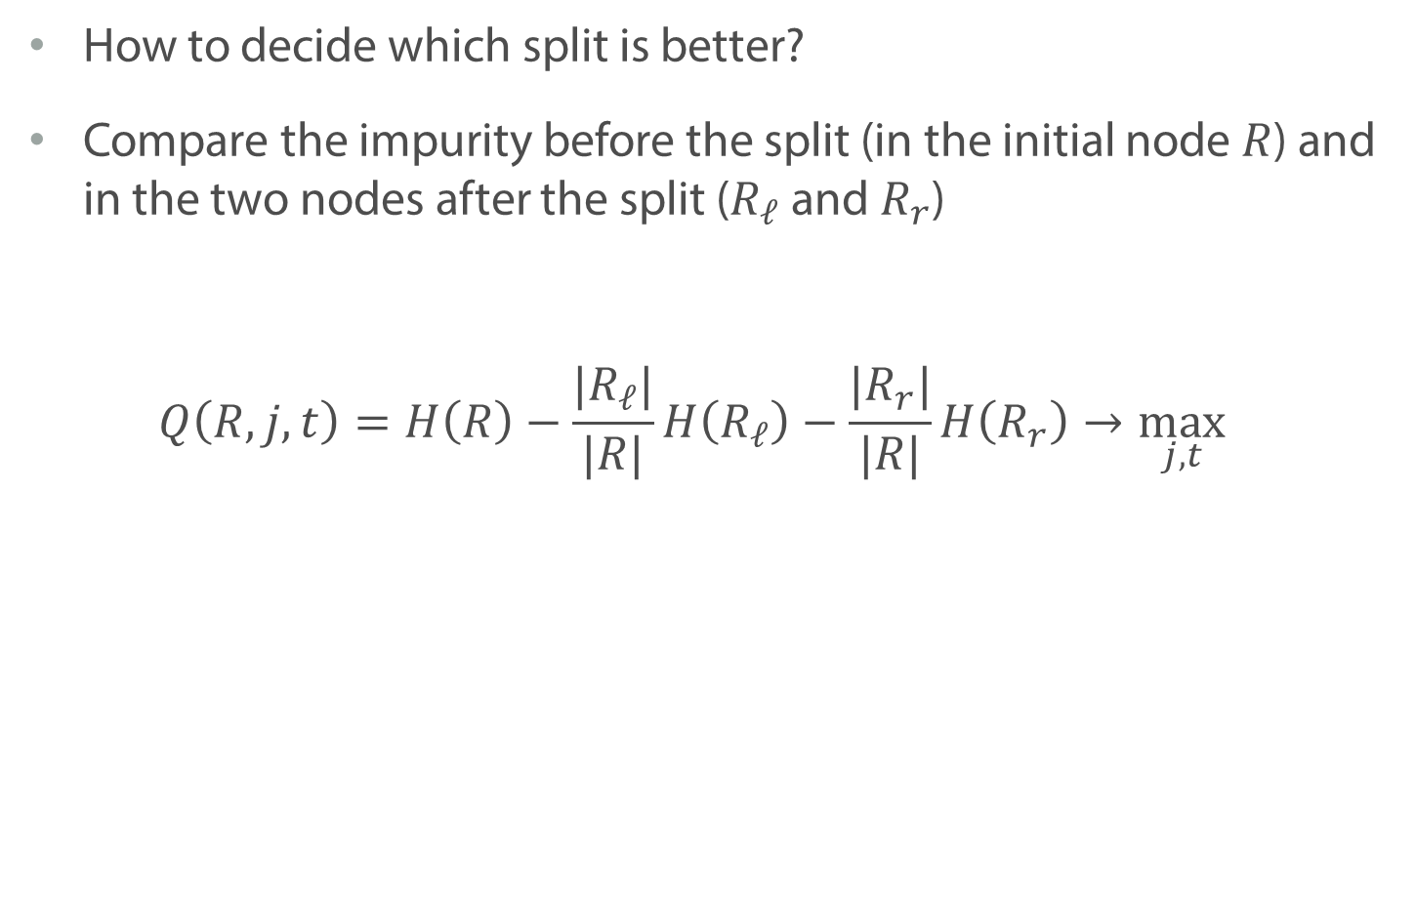
Impurity Criterions
How to decide which split is better?
Compare the impurity before the split (in the initial node $R$) and in the two nodes after the split ($R_{ℓ}$and $R_{r}$)
$$Q\left(R, j, t\right)=H\left(R\right)−\frac{|R_{ℓ}|}{|R|}H\left(R_{ℓ}\right)−\frac{|R_{r}|}{|R|}H\left(R_{r}\right)→\max_{j, t}{}$$

Slide 68
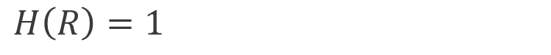
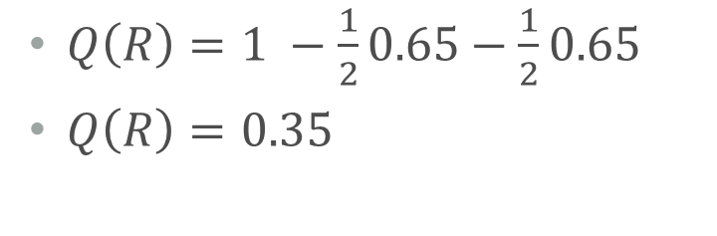
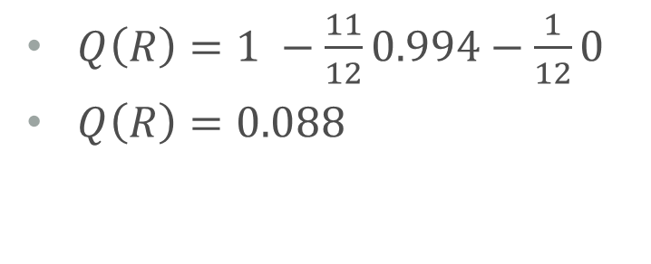
How to Compare Two Splits?
$$H\left(R\right)=1$$
$Q\left(R\right)=1 −\frac{1}{2}0.65−\frac{1}{2}0.65$
$Q\left(R\right)=0.35$
0.65
0.65
$Q\left(R\right)=1 −\frac{11}{12}0.994−\frac{1}{12}0$
$Q\left(R\right)=0.088$
0.994
0

Slide 69
Greedy Construction: Regression
10
1
2
12
0
11
10
1
2
12
0
11

Slide 70
Greedy Construction: Regression
10
1
2
12
0
11
10
1
12
11
0
2

Slide 71
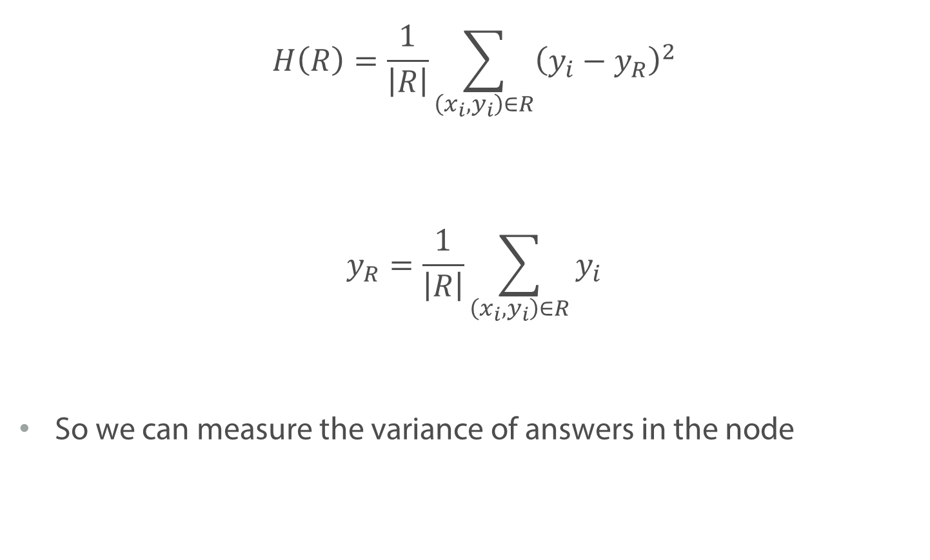
Regression Task
$$H\left(R\right)=\frac{1}{\left|R\right|}\sum_{\left(x_{i}, y_{i}\right)∈R}{{\left(y_{i}−y_{R}\right)}^{2}}$$
$$y_{R}=\frac{1}{\left|R\right|}\sum_{\left(x_{i}, y_{i}\right)∈R}{y_{i}}$$
So we can measure the variance of answers in the node

Slide 72
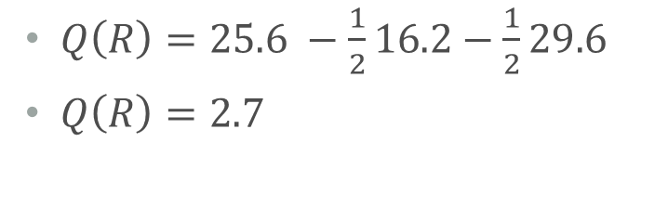
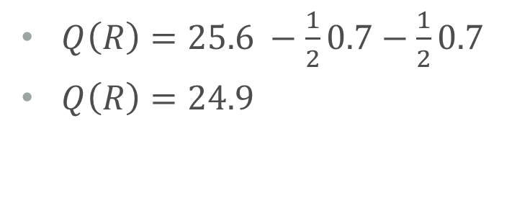
How to Compare Two Splits?
$$H\left(R\right)=25.6$$
$Q\left(R\right)=25.6 −\frac{1}{2}16.2−\frac{1}{2}29.6$
$Q\left(R\right)=2.7$
10
1
0
11
2
12
16.2
29.6
$Q\left(R\right)=25.6 −\frac{1}{2}0.7−\frac{1}{2}0.7$
$Q\left(R\right)=24.9$
10
11
0
1
12
2
0.7
0.7

Slide 73
Summary
We can choose the split, so that it reduces the diversity of answers in the resulting nodes
We use impurity criterion to measure the quality of the split
There are different criterions that might be used. The most popular are:
Entropy and Gini for classification
Variance for regression

Slide 74
Greedy Tree Construction

Slide 75
How to Construct a Tree?
Optimal option:
Try all possible trees and select the smallest one
That is too computationally expensive

Slide 76
How to Construct a Tree?
We know how to choose the best split for a given node
Let’s use greedy algorithm
We start from the root node and will be splitting until some stopping criterion is satisfied

Slide 77
Stopping Criterions
Restrict the maximal depth
Restrict the number of leaves
Fix the minimal number of objects in the node
Set the minimal decrease in the diversity when splitting
etc.

Slide 78
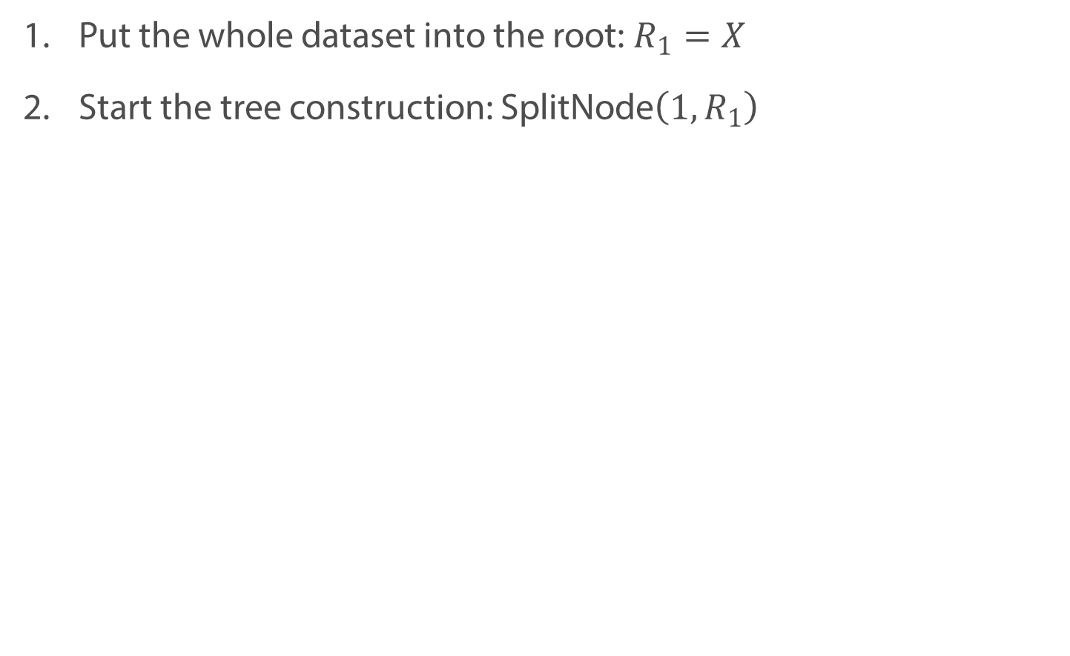
Greedy Algorithm
Put the whole dataset into the root: $R_{1}=X$
Start the tree construction: $\text{SplitNode}\left(1, R_{1}\right)$

Slide 79
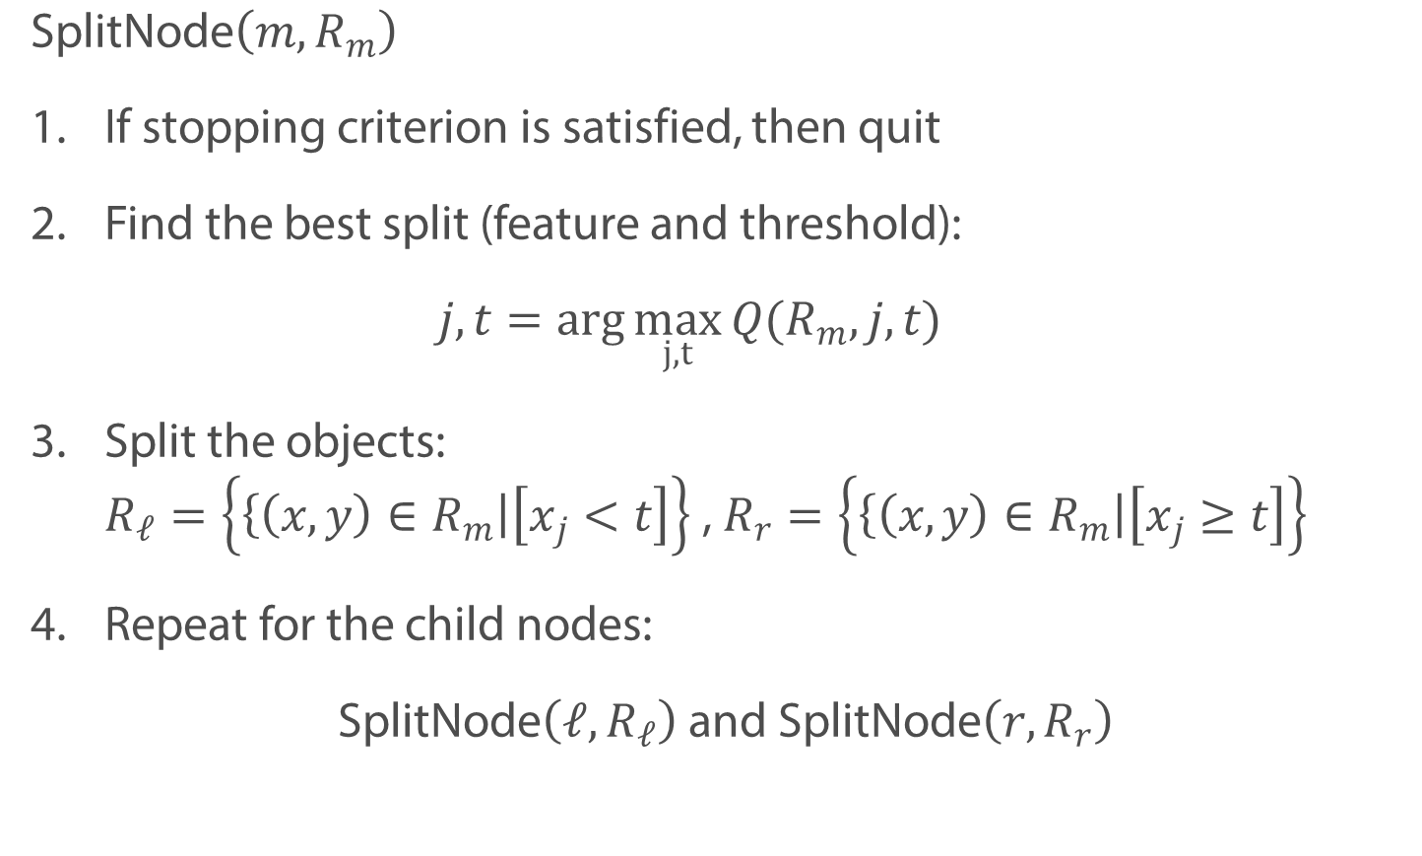
Greedy Algorithm
$$\text{SplitNode}\left(m, R_{m}\right)$$
If stopping criterion is satisfied, then quit
Find the best split (feature and threshold):
$$j, t=\arg{\max_{j,t}{Q(R_{m}, j, t)}}$$
Split the objects: $R_{ℓ}=\left\{\left\{\left(x, y\right)∈R_{m}\right|\left[x_{j}<t\right]\right\}$, $R_{r}=\left\{\left\{\left(x, y\right)∈R_{m}\right|\left[x_{j}≥t\right]\right\}$
Repeat for the child nodes:
$\text{SplitNode}\left(ℓ, R_{ℓ}\right)$ and $\text{SplitNode}\left(r, R_{r}\right)$

Slide 80
Greedy Algorithm

Slide 81
Greedy Algorithm

Slide 82
Splitting on the first feature
1
2
3
6
7
8

Slide 83
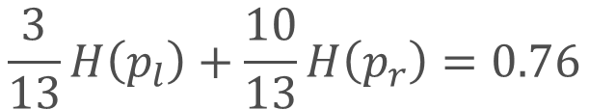
Splitting on the first feature
1
(1, 0)
H(p) = 0
(1/2, 1/2)
H(p) = 1
$$\frac{3}{13}H\left(p_{l}\right)+\frac{10}{13}H\left(p_{r}\right)=0.76$$

Slide 84
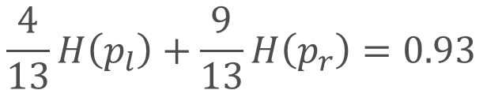
Splitting on the first feature
2
(3/4, 1/4)
H(p) = 0.81
(5/9, 4/9)
H(p) = 0.99
$$\frac{4}{13}H\left(p_{l}\right)+\frac{9}{13}H\left(p_{r}\right)=0.93$$

Slide 85
Splitting on the Second Feature
5
3
2
1

Slide 86
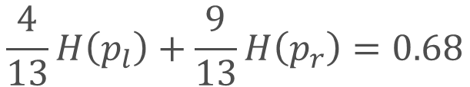
Splitting on the Second Feature
(4/9, 5/9)
H(p) = 0.99
$$\frac{4}{13}H\left(p_{l}\right)+\frac{9}{13}H\left(p_{r}\right)=0.68$$
1
(1, 0)
H(p) = 0

Slide 87
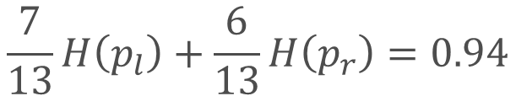
Splitting on the Second Feature
Splitting on the Second Feature
(4/6, 2/6)
H(p) = 0.91
$$\frac{7}{13}H\left(p_{l}\right)+\frac{6}{13}H\left(p_{r}\right)=0.94$$
2
(4/7, 3/7)
H(p) = 0.98

Slide 88
Splitting on the Second Feature
(4/9, 5/9)
H(p) = 0.99
$$\frac{4}{13}H\left(p_{l}\right)+\frac{9}{13}H\left(p_{r}\right)=0.68$$
1
The Best Split
(1, 0)
H(p) = 0

Slide 89
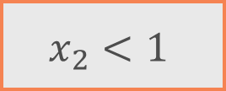
Greedy Algorithm
$$x_{2}<1$$

Slide 90
Greedy Algorithm
Greedy Algorithm
$$x_{2}<1$$
The leaf

Slide 91

Greedy Algorithm
$$x_{2}<1$$
$$x_{1}<1$$

Slide 92

Greedy Algorithm
$$x_{2}<1$$
$$x_{1}<1$$
$$x_{1}<8$$

Slide 93
Summary
We use greedy algorithm to construct a tree
At each step we select the best split
The algorithm is quite complex and requires brute force of all the splits at each step

Slide 94
High Variance of Decision Trees

Slide 95
Decision Trees and Overfitting

Slide 96
Variance
Variance – sensitivity of the model to the fluctuations in the data
Low Variance
High Variance

Slide 97

Stability of a Model
$X={\left(x_{i},y_{i}\right)}_{i=1}^{ℓ}$ — training dataset
If the model has low variance, we expect is to look similar if we use different subset of the initial training dataset
$\tilde{X}$ — random subsample, approx. 90% from the initial
Let us train decision trees on different $\tilde{X}$

Slide 98

Training Decision Tree on Subsamples

Slide 99

Training Decision Tree on Subsamples

Slide 100

Training Decision Tree on Subsamples

Slide 101
Decision Trees
High variance
Lack of smoothness

Slide 102

Composition of Models

Slide 103
Summary
Decision trees are very sensitive to the changes in the dataset
Prediction surface of decision trees in very non-smooth
In practice composition of decision trees is used

Slide 104
Working with Categorical Features

Slide 105
Ensembles

Slide 106
Composition of Decision Trees

Slide 107
Week Goals
What is model composition and why do we need it
Bagging and Random Forest
Gradient boosting

Slide 108
Training Decision Tree on Subsamples

Slide 109
Composition of Models

Slide 110

Composition of Models
Let us train $M$ decision trees: $b_{1}\left(x\right), …, b_{M}\left(x\right)$
Combine them through majority vote:
$$a_{M}\left(x\right)=\arg{\max_{y∈𝕐}{\sum_{m=1}^{M}{\left[b_{m}\left(x\right)=y\right]}}}$$

Slide 111

Composition of Models

Slide 112

General Formulation: Classification
$b_{1}\left(x\right), …, b_{M}\left(x\right)$ – base models
Composition through majority vote:
$$a_{M}\left(x\right)=\arg{\max_{y∈𝕐}{\sum_{m=1}^{M}{\left[b_{m}\left(x\right)=y\right]}}}$$

Slide 113

General Formulation: Regression
$b_{1}\left(x\right), …, b_{M}\left(x\right)$ – base models
Composition through averaging:
$$a_{M}\left(x\right)=\frac{1}{M}\sum_{m=1}^{M}{b_{m}\left(x\right)}$$

Slide 114

Base Models
$b_{1}\left(x\right), …, b_{M}\left(x\right)$ – base models
How to build $M$ different models using only 1 training dataset?

Slide 115

Base Models
$b_{1}\left(x\right), …, b_{M}\left(x\right)$ – base models
How to build $M$ different models using only 1 training dataset?
Two options:
Train independently on different subsamples
Bagging
Random subspaces
Train successively to correct error of the previous algorithm
Boosting

Slide 116
Bagging
Bagging (bootstrap aggregating)
Base algorithms are trained independently
Each models is trained on the subsample of the training dataset
The subsample is obtained by bootstrap.

Slide 117

Bootstrap
Sample with replacement
Select $N$ elements from $X$ (where $N$ is the size of the training dataset)
E.g.: $\left\{x_{1}, x_{2}, x_{3}, x_{4}\right\}→\left\{x_{1},x_{2},x_{2},x_{4}\right\}$
Our subsample will have approximately 63.2% unique observations

Slide 118
Random Subspaces
Base algorithms are trained independently
Use random subset of features for each model
May work poorly if some feature is crucial for a reasonable model

Slide 119
Sources of Randomness
Bagging: random subset
Random subspaces: random set of features

Slide 120
Summary
We can create compositions of models through averaging and majority voting
Bagging — ensemble of methods trained independently on random subsets
We can also select random subsets of features

Slide 121
Random Forest

Slide 122

Bias-variance trade-off
$${𝔼{[y −a\left(x\right)]}^{2}= bias}^{2}+Variance$$
Error
Bias²
Variance
Model Complexity
Notes:
It can be shown, that the expected squared error of the model on the test set the sum of the squared bias and variance. You can see it on the graph, depicted with the black line

Slide 123

Linear Models: High Bias and Low Variance

Slide 124

Decision Trees: Low Bias and High Variance

Slide 125

Composition of Algorithms
$b_{1}\left(x\right), …, b_{M}\left(x\right)$ — base models
Composition through averaging:
$$a_{M}\left(x\right)=\frac{1}{M}\sum_{m=1}^{M}{b_{m}\left(x\right)}$$
Composition through majority vote:
$$a_{M}\left(x\right)=\arg{\max_{y∈𝕐}{\sum_{m=1}^{M}{\left[b_{m}\left(x\right)=y\right]}}}$$

Slide 126

Bias and Variance for Composition
Bias:
$a_{M}\left(x\right)$ h$as the same bias as b_{m}\left(x\right)$
Variance:
$$Var\left(a_{M}\left(x\right)\right)=\frac{1}{M}\left(Var b_{m}\left(x\right)\right)+Cov\left(b_{m}\left(x\right), b_{k}\left(x\right)\right)$$

Slide 127

Bias and Variance for Composition
Bias:
$a_{M}\left(x\right)$ h$as the same bias as b_{m}\left(x\right)$
Variance:
$$Var\left(a_{M}\left(x\right)\right)=\frac{1}{M}\left(Var b_{m}\left(x\right)\right)+Cov\left(b_{m}\left(x\right), b_{k}\left(x\right)\right)$$
If base models are independent, variance is $M$ time smaller
The more correlated models are, the less is effect of the ensemble

Slide 128

Composition of Decision Trees
We need base models with low bias – decision trees

Slide 129

Decision Trees: Greedy Algorithm
$$\text{SplitNode}\left(m, R_{m}\right)$$
If stopping criterion is satisfied, then quit
Find the best split (feature and threshold):
$$j, t=\arg{\max_{j,t}{Q(R_{m}, j, t)}}$$
Split the objects: $R_{ℓ}=\left\{\left\{\left(x, y\right)∈R_{m}\right|\left[x_{j}<t\right]\right\}$, $R_{r}=\left\{\left\{\left(x, y\right)∈R_{m}\right|\left[x_{j}≥t\right]\right\}$
Repeat for the child nodes:
$\text{SplitNode}\left(ℓ, R_{ℓ}\right)$ and $\text{SplitNode}\left(r, R_{r}\right)$

Slide 130

Decision Trees: Greedy Algorithm
$$\text{SplitNode}\left(m, R_{m}\right)$$
If stopping criterion is satisfied, then quit
Find the best split (feature and threshold):
$$j, t=\arg{\max_{j,t}{Q(R_{m}, j, t)}}$$
Split the objects: $R_{ℓ}=\left\{\left\{\left(x, y\right)∈R_{m}\right|\left[x_{j}<t\right]\right\}$, $R_{r}=\left\{\left\{\left(x, y\right)∈R_{m}\right|\left[x_{j}≥t\right]\right\}$
Repeat for the child nodes:
$\text{SplitNode}\left(ℓ, R_{ℓ}\right)$ and $\text{SplitNode}\left(r, R_{r}\right)$

Slide 131

Finding Optimal Split
$$j, t=\arg{\min_{j,t}{Q(R_{m}, j, t)}}$$
We will consider random subset of features of size $q,$ selected randomly for each node

Slide 132
Correlation Between Trees
Hastie, Tibshirani, Friedman. The Elements of Statistical Learning.

Slide 133

Correlation Between Trees
Recommended values of $q$:
Regression task: $q=\frac{d}{3}$
Classification task: $q=\sqrt{d}$
Where $d$ is the total number of features in the dataset

Slide 134

Random Forest
For $m=1, …, M:$
Sample $\tilde{X}$ from the training dataset using bootstrap
Train decision tree $b_{m}\left(x\right)$ on $\tilde{X}$
Stopping criterion: $n_{min}$ objects in the leaf
Select $q$ feature randomly before selecting optimal split in each node

Slide 135

Random Forest
For $m=1, …, M:$
Sample $\tilde{X}$ from the training dataset using bootstrap
Train decision tree $b_{m}\left(x\right)$ on $\tilde{X}$
Stopping criterion: $n_{min}$ objects in the leaf
Select $q$ feature randomly before selecting optimal split in each node

Slide 136

Random Forest
Regression:
$$a\left(x\right)=\frac{1}{M}\sum_{m=1}^{M}{b_{m}\left(x\right)}$$
Classification:
$$a\left(x\right)=\arg{\max_{y∈𝕐}{\sum_{m=1}^{M}{\left[b_{m}\left(x\right)=y\right]}}}$$

Slide 137


Universal Method
Error is large, when we do not have enough base models
Random forest does not overfit even for large $M$

Slide 138

Out-of-bag
Each tree uses approximately 63% of the observations
The rest can be used as a validation set
$X_{m}$ – t$raining dataset for b_{m}\left(x\right)$
We can estimate error:
$$L_{val}=\frac{1}{N}\sum_{i=1}^{N}{l\left(y_{i},\frac{1}{\sum_{m=1}^{M}{\left[x_{i}∉X_{m}\right]}}\sum_{m=1}^{M}{\left[x_{i}∉X_{m}\right]b_{m}\left(x_{i}\right)}\right)}$$

Slide 139
Feature Importance
Mix the column with the feature of interest in the test dataset
Evaluate the model
The more is the drop in the prediction quality, the more important is the feature

Slide 140
Summary
Random Forest — bagging-based algorithm, where we use decision trees as base models and reduce their correlation using random subspaces
Method does not have any hyperparameters
We can evaluate generalization ability without validation set

Slide 141
Random Forest: Example

Slide 142
Boosting Idea

Slide 143

Base Models
$b_{1}\left(x\right), …, b_{M}\left(x\right)$ — base models
How to build $M$ different models using only 1 training dataset?
Two options:
Train independently on different subsamples
Bagging
Random subspaces
Train successively to correct error of the previous algorithm
Boosting

Slide 144

Problems with Bagging
$a_{M}\left(x\right)$ has the same bias as $b_{m}\left(x\right)$
If base model if biased, the composition of such models will still be highly biased
It takes a lot of time and memory to train and store base models

Slide 145
Boosting Idea
Let us use very simple base models (weak learners)
We will construct an ensemble successively and greedily
Each successive model will try to correct the errors of the previous ones

Slide 146

Boosting Idea
$$a_{M}\left(x\right)=\sum_{m=1}^{M}{b_{m}\left(x\right)}$$
Training the first base model:
$$\min_{b_{1}\left(x\right)}L\left(b_{1}, X\right)=\min_{b_{1}\left(x\right)}\frac{1}{N}\sum_{i=1}^{N}{l\left(y_{i}, b_{1}\left(x_{i}\right)\right)}$$

Slide 147

Boosting Idea
$$a_{M}\left(x\right)=\sum_{m=1}^{M}{b_{m}\left(x\right)}$$
Training the Mth base model:
$$\min_{b_{M}\left(x\right)}\frac{1}{N}\sum_{i=1}^{N}{l\left(y_{i},a_{M−1}\left(x_{i}\right)+b_{M}\left(x_{i}\right)\right)}$$

Slide 148

Boosting Idea
$$a_{M}\left(x\right)=\sum_{m=1}^{M}{b_{m}\left(x\right)}$$
Training the Mth base model:
$$\min_{b_{M}\left(x\right)}\frac{1}{N}\sum_{i=1}^{N}{l\left(y_{i},a_{M−1}\left(x_{i}\right)+b_{M}\left(x_{i}\right)\right)}$$
The main question is how to learn a tree with such loss in general case

Slide 149
Summary
In boosting we train models successively
Each successive model corrects errors of the previous one
In general case we get a very complex loss function

Slide 150
Boosting for MSE Loss

Slide 151

Boosting Idea
$$a_{M}\left(x\right)=\sum_{m=1}^{M}{b_{m}\left(x\right)}$$
Training the Mth base model:
$$\min_{b_{M}\left(x\right)}\frac{1}{N}\sum_{i=1}^{N}{l\left(y_{i},a_{M−1}\left(x_{i}\right)+b_{M}\left(x_{i}\right)\right)}$$

Slide 152

Boosting for MSE
$$a_{M}\left(x\right)=\sum_{m=1}^{M}{b_{m}\left(x\right)}$$
Training the Mth base model:
$$\min_{b_{M}\left(x\right)}\frac{1}{N}\sum_{i=1}^{N}{{\left(y_{i}−a_{M−1}\left(x_{i}\right)+b_{M}\left(x_{i}\right)\right)}^{2}}$$

Slide 153

Boosting for MSE
$$a_{M}\left(x\right)=\sum_{m=1}^{M}{b_{m}\left(x\right)}$$
Training the Mth base model:
$$\min_{b_{M}\left(x\right)}\frac{1}{N}\sum_{i=1}^{N}{{\left(b_{M}\left(x_{i}\right)−(a_{M−1}\left(x_{i}\right){−y}_{i})\right)}^{2}}$$

Slide 154


Boosting for MSE
$$a_{M}\left(x\right)=\sum_{m=1}^{M}{b_{m}\left(x\right)}$$
Training the Mth base model:
$$\min_{b_{M}\left(x\right)}\frac{1}{N}\sum_{i=1}^{N}{{\left(b_{M}\left(x_{i}\right)−(a_{M−1}\left(x_{i}\right){−y}_{i})\right)}^{2}}$$
Residuals — $s_{i}^{(M)}=a_{M−1}\left(x_{i}\right)−y_{i}$
$$s_{i}^{(M)}$$

Slide 155

First Iteration
$$\frac{1}{N}\sum_{i=1}^{N}{{\left(b_{1}\left(x_{i}\right)−y_{i}\right)}^{2}}→\min_{b_{1}\left(x\right)}{}$$

Slide 156

Second Iteration
$$\frac{1}{N}\sum_{i=1}^{N}{{\left(b_{2}\left(x_{i}\right)−\left(y_{i}−b_{1}\left(x_{i}\right)\right)\right)}^{2}}→\min_{b_{2}\left(x\right)}{}$$

Slide 157

Third Iteration
$$\frac{1}{N}\sum_{i=1}^{N}{{\left(b_{3}\left(x_{i}\right)−\left(y_{i}−b_{1}\left(x_{i}\right)−b_{2}\left(x_{i}\right)\right)\right)}^{2}}→\min_{b_{3}\left(x\right)}{}$$

Slide 158
Example

Slide 159
Example

Slide 160
Example

Slide 161
Random Forest

Slide 162
Boosting Error on Train and Test

Slide 163
Summary
In case of MSE loss, boosting boils down to conventional model training with a changed target variable
Boosting is prone to overfitting, thus, it is essential to use validation dataset

Slide 164
Difficulties of Training with General Loss Function

Slide 165

Training a Weak Learner
$$a_{M}\left(x\right)=\sum_{m=1}^{M}{b_{m}\left(x\right)}$$
Training $Mth$ model:
$$\frac{1}{N}\sum_{i=1}^{N}{l\left(y_{i}, a_{M−1}\left(x_{i}\right)+b_{M}\left(x_{i}\right)\right)}→\min_{b_{M}\left(x\right)}{}$$

Slide 166

Training a Weak Learner
$$\frac{1}{N}\sum_{i=1}^{N}{l\left(y_{i}, a_{M−1}\left(x_{i}\right)+b_{M}\left(x_{i}\right)\right)}→\min_{b_{M}\left(x\right)}{}$$
Can we just use residuals as new targets, as we did with MSE?
$$\frac{1}{N}\sum_{i=1}^{N}{l\left(y_{i}−a_{M−1}\left(x_{i}\right),b_{M}\left(x_{i}\right)\right)}→\min_{b_{M}\left(x\right)}{}$$

Slide 167

Logistic Loss
$$a_{M}\left(x\right)=\text{sign}\sum_{m=1}^{M}{b_{m}\left(x\right)}$$
$$l\left(y, z\right)=\log\left(1+\exp\left(−yz\right)\right)$$
Can we just use residuals as new targets, as we did with MSE?
$$\frac{1}{N}\sum_{i=1}^{N}{\log\left(1+\exp\left(−\left(y_{i}−a_{M−1}\left(x_{i}\right)\right)b_{M}\left(x_{i}\right)\right)\right)}→\min_{b_{M}\left(x\right)}{}$$
If $y_{i}=a_{N−1}\left(x_{i}\right)$, the object is not used in training anymore
Otherwise $y_{i}−a_{M−1}\left(x_{i}\right)=±2$

Slide 168

Logistic Loss
$$\frac{1}{N}\sum_{i=1}^{N}{\log\left(1+\exp\left(−\frac{y_{i}−a_{M−1}\left(x_{i}\right)}{2}b_{M}\left(x_{i}\right)\right)\right)}→\min_{b_{M}\left(x\right)}{}$$
If $y_{i}=a_{N−1}\left(x_{i}\right)$, the object is not used in training
If $y_{i}≠a_{N−1}\left(x_{i}\right)$, the base model is trained to output correct class

Slide 169

Logistic Loss
$$\frac{1}{N}\sum_{i=1}^{N}{\log\left(1+\exp\left(−\frac{y_{i}−a_{M−1}\left(x_{i}\right)}{2}b_{M}\left(x_{i}\right)\right)\right)}→\min_{b_{M}\left(x\right)}{}$$
Let $y_{i}=+1$ and $\sum_{m=1}^{M−1}{b_{m}\left(x_{i}\right)}=−0.5$
We need $b_{M}\left(x_{i}\right)>0.5$
Let $y_{i}=+1$ and $\sum_{m=1}^{M−1}{b_{m}\left(x_{i}\right)}=−100$
We need $b_{M}\left(x_{i}\right)>100$

Slide 170

Logistic Loss
$$\frac{1}{N}\sum_{i=1}^{N}{\log\left(1+\exp\left(−\frac{y_{i}−a_{M−1}\left(x_{i}\right)}{2}b_{M}\left(x_{i}\right)\right)\right)}→\min_{b_{M}\left(x\right)}{}$$
Let $y_{i}=+1$ and $\sum_{m=1}^{M−1}{b_{m}\left(x_{i}\right)}=−0.5$
We need $b_{M}\left(x_{i}\right)>0.5$
Let $y_{i}=+1$ and $\sum_{m=1}^{M−1}{b_{m}\left(x_{i}\right)}=−100$
We need $b_{M}\left(x_{i}\right)>100$
Both objects will have the same margin
We are not controlling output of the $b_{M}\left(x\right)$ on the objects with correct predictions

Slide 171

MSLE
Mean Squared Logarithmic Error
$$l\left(y, z\right)={\left(\log\left(z+1\right)−\log\left(y+1\right)\right)}^{2}$$

Slide 172

MSLE
$$a_{M}\left(x\right)=\sum_{m=1}^{M}{b_{m}\left(x\right)}$$
$$l\left(y, z\right)={\left(\log\left(z+1\right)−\log\left(y+1\right)\right)}^{2}$$
Can we just use residuals as new targets, as we did with MSE?
$$\frac{1}{N}\sum_{i=1}^{N}{{\left(\log\left(b_{M}\left(x_{i}\right)+1\right)−\log\left(y_{i}−a_{M−1}\left(x_{i}\right)+1\right)\right)}^{2}}→\min_{b_{M}\left(x\right)}{}$$

Slide 173

MSLE
$$a_{M}\left(x\right)=\sum_{m=1}^{M}{b_{m}\left(x\right)}$$
$$l\left(y, z\right)={\left(\log\left(z+1\right)−\log\left(y+1\right)\right)}^{2}$$
Can we just use residuals as new targets, as we did with MSE?
$$\frac{1}{N}\sum_{i=1}^{N}{{\left(\log\left(b_{M}\left(x_{i}\right)+1\right)−\log\left(y_{i}−a_{M−1}\left(x_{i}\right)+1\right)\right)}^{2}}→\min_{b_{M}\left(x\right)}{}$$
We can get logarithm of a negative number

Slide 174


MSLE
$$\frac{1}{N}\sum_{i=1}^{N}{{\left(\log\left(b_{M}\left(x_{i}\right)+1\right)−\log\left(y_{i}−a_{M−1}\left(x_{i}\right)+1\right)\right)}^{2}}→\min_{b_{N}\left(x\right)}{}$$
$$y_{i}$$ | $$a_{M−1}\left(x_{i}\right)$$ | $$b_{M}\left(x_{i}\right)$$ | Improvement of MSLE for composition | Improvement of the base model loss
1000 | 100 | 2 | 0.09 | 13.7
2 | 0 | 2 | 1.2 | 1.2

Slide 175
Summary
We cannot just use residuals instead of the real target to train weak learners with arbitrary loss
This does not take into account specificities of a loss function

Slide 176
Gradient Boosting in General Form

Slide 177

Training a base model
$Mth$base model:
$$\frac{1}{N}\sum_{i=1}^{N}{l\left(y_{i}, a_{M−1}\left(x_{i}\right)+b_{M}\left(x_{i}\right)\right)}→\min_{b_{M}\left(x\right)}{}$$
How to decide, in which direction and how hard to change $a_{M−1}\left(x_{i}\right)$ in order to reduce an error?

Slide 178

Training a base model
$Mth$base model:
$$\frac{1}{N}\sum_{i=1}^{N}{l\left(y_{i}, a_{M−1}\left(x_{i}\right)+b_{M}\left(x_{i}\right)\right)}→\min_{b_{M}\left(x\right)}{}$$
How to decide, in which direction and how hard to change $a_{M−1}\left(x_{i}\right)$ in order to reduce an error?
Calculate the gradient

Slide 179

Training a base model
$Mth$base model:
$$\frac{1}{N}\sum_{i=1}^{N}{l\left(y_{i}, a_{M−1}\left(x_{i}\right)+b_{M}\left(x_{i}\right)\right)}→\min_{b_{M}\left(x\right)}{}$$
How to decide, in which direction and how hard to change $a_{M−1}\left(x_{i}\right)$ in order to reduce an error?
Calculate the gradient
$$s_{i}^{(M)}=−{\left.\frac{∂}{∂z}l\left(y_{i}, z\right)\right|}_{z=a_{M−1}\left(x_{i}\right)}$$

Slide 180

Training a base model
Calculate the gradient
$$s_{i}^{(M)}=−{\left.\frac{∂}{∂z}l\left(y_{i}, z\right)\right|}_{z=a_{M−1}\left(x_{i}\right)}$$
The sign shows the direction in which we should change the prediction for the object $x_{i}$, to reduce the error of the composition on it
The absolute value shows how large the decrease in the error will be
If there is no decrease in the error, there is no point in changing the prediction

Slide 181

Gradient Boosting
Training $Mth$ model:
$$\frac{1}{N}\sum_{i=1}^{N}{{\left(b_{M}\left(x_{i}\right)−s_{i}^{(M)}\right)}^{2}}→\min_{b_{M}\left(x\right)}{}$$
$s_{i}^{(M)}=−{\left.\frac{∂}{∂z}l\left(y_{i}, z\right)\right|}_{z=a_{M−1}\left(x_{i}\right)}$— residuals

Slide 182

Gradient Boosting
Training $Mth$ model:
$$\frac{1}{N}\sum_{i=1}^{N}{{\left(b_{M}\left(x_{i}\right)−s_{i}^{(M)}\right)}^{2}}→\min_{b_{M}\left(x\right)}{}$$
$s_{i}^{(M)}=−{\left.\frac{∂}{∂z}l\left(y_{i}, z\right)\right|}_{z=a_{M−1}\left(x_{i}\right)}$— residuals
Gradient Descent in the space of answers on the training set
New base model will correct the predictions so that total error of the ensemble will be smaller
Residuals take into account specific loss function

Slide 183

Gradient Boosting for MSE
$$s_{i}^{(M)}=−{\left.\frac{∂}{∂z}l\left(y_{i}, z\right)\right|}_{z=a_{M−1}\left(x_{i}\right)}=−{\left.\frac{∂}{∂z}{\frac{1}{2}\left(z−y_{i}\right)}^{2}\right|}_{z=a_{M−1}\left(x_{i}\right)}=$$
$$=−\left(a_{M−1}\left(x_{i}\right)−y_{i}\right)=y_{i}−a_{M−1}\left(x_{i}\right)$$

Slide 184

Gradient Boosting for MSE
$$s_{i}^{(M)}=−{\left.\frac{∂}{∂z}l\left(y_{i}, z\right)\right|}_{z=a_{M−1}\left(x_{i}\right)}=−{\left.\frac{∂}{∂z}{\frac{1}{2}\left(z−y_{i}\right)}^{2}\right|}_{z=a_{M−1}\left(x_{i}\right)}=$$
$$=−\left(a_{M−1}\left(x_{i}\right)−y_{i}\right)=y_{i}−a_{M−1}\left(x_{i}\right)$$
$$\frac{1}{N}\sum_{i=1}^{N}{{\left(b_{M}\left(x_{i}\right)−\left(y_{i}−a_{M−1}\left(x_{i}\right)\right)\right)}^{2}}→\min_{b_{M}\left(x\right)}{}$$

Slide 185

Gradient Boosting for Logistic Loss
$$s_{i}^{(M)}=−{\left.\frac{∂}{∂z}l\left(y_{i}, z\right)\right|}_{z=a_{M−1}\left(x_{i}\right)}=$$
$$=−{\left.\frac{∂}{∂z}\log\left(1+\exp\left(−y_{i}z\right)\right)\right|}_{z=a_{M−1}\left(x_{i}\right)}=$$
$$=\frac{y_{i}}{1+\exp\left(y_{i}a_{M−1}\left(x_{i}\right)\right)}$$

Slide 186

Gradient Boosting for Logistic Loss
$$s_{i}^{(M)}=−{\left.\frac{∂}{∂z}l\left(y_{i}, z\right)\right|}_{z=a_{M−1}\left(x_{i}\right)}=$$
$$=−{\left.\frac{∂}{∂z}\log\left(1+\exp\left(−y_{i}z\right)\right)\right|}_{z=a_{M−1}\left(x_{i}\right)}=$$
$$=\frac{y_{i}}{1+\exp\left(y_{i}a_{M−1}\left(x_{i}\right)\right)}$$
$$\frac{1}{N}\sum_{i=1}^{N}{{\left(b_{M}\left(x_{i}\right)−\frac{y_{i}}{1+\exp\left(y_{i}a_{M−1}\left(x_{i}\right)\right)}\right)}^{2}}→\min_{b_{M}\left(x\right)}{}$$

Slide 187

Gradient Boosting for Logistic Loss
$$\frac{1}{N}\sum_{i=1}^{N}{{\left(b_{M}\left(x_{i}\right)−\frac{y_{i}}{1+\exp\left(y_{i}a_{M−1}\left(x_{i}\right)\right)}\right)}^{2}}→\min_{b_{M}\left(x\right)}{}$$
Large positive margin: $\frac{y_{i}}{1+\exp\left(y_{i}a_{M−1}\left(x_{i}\right)\right)}≈0$
Large negative margin:$\frac{y_{i}}{1+\exp\left(y_{i}a_{M−1}\left(x_{i}\right)\right)}≈±1$

Slide 188
Summary
To incorporate properties of a specific loss function, we can compute its gradient in the current predicted values of the ensemble
We will train a base model to fit the gradients with minus sign

Slide 189
Hyperparameters and Regularization for Boosting

Slide 190

Gradient Boosting
Training $Mth$ model:
$$\frac{1}{N}\sum_{i=1}^{N}{{\left(b_{M}\left(x_{i}\right)−s_{i}^{(M)}\right)}^{2}}→\min_{b_{M}\left(x\right)}{}$$
$s_{i}^{(M)}=−{\left.\frac{∂}{∂z}l\left(y_{i}, z\right)\right|}_{z=a_{M−1}\left(x_{i}\right)}$— residuals

Slide 191
Tree Depth
Gradient Boosting reduces the bias of base models
Variance may increase
Hence, it is worth using simple algorithms, e.g. trees with small depth
Fix the depth
Fix maximal number of leaves

Slide 192
Problems of Boosting Algorithm
Residuals show the desired direction on the whole training dataset
Base models are supposed to be simple and may not be powerful enough to fit the residuals

Slide 193
Problems of Boosting Algorithm
Residuals show the desired direction on the whole training dataset
Base models are supposed to be simple and may not be powerful enough to fit the residuals
Solution: add trees to the composition with the small weight

Slide 194

Step Size
$$a_{M}\left(x\right)=a_{M−1}\left(x_{i}\right)+ηb_{M}\left(x_{i}\right)$$
$η∈\left(0, 1\right]$ — step size
One can think that it is a regularization of the composition
We reduce the influence of each model
The smaller the step size is, the more trees are needed

Slide 195

Step Size

Slide 196
Feature Randomization
We can train trees on random subspaces
Boosting reduces bias, therefore the final composition will be still good enough
At the same time, it may reduce overfitting

Slide 197

Feature Randomization

Slide 198
Hyperparameters
Tree Depth
Total number of trees
Step size
Size of the subset (used to train a tree)
Etc.

Slide 199
Summary
Boosting reduces the bias of base models, but may increase variance. Therefore we need to use simple base learners
To reduce overfitting, we may add trees to the composition with the small weights
Another solution is to use subsets of features for each base algorithm

Slide 200
Boosting Implementations

